Slide 2
Fruit and the Sweetness of God

Slide 3
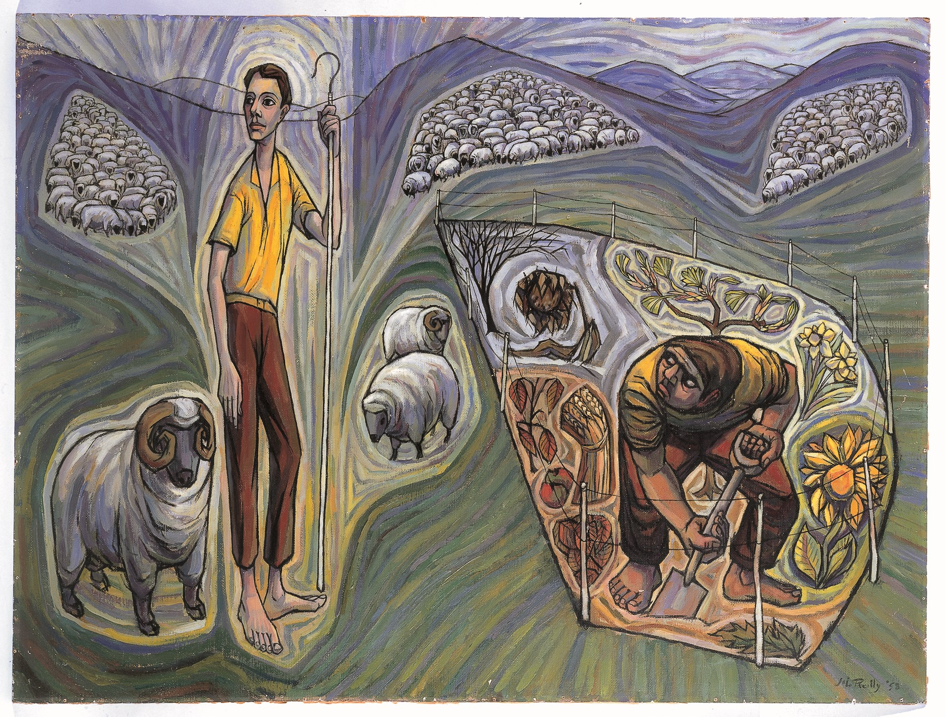
“Will you not be accepted?” (Genesis 4.1-16)
After the call to “be fruitful and multiply”, man falls but still is blessed with two sons – Cain and Abel.
Cain brings fruit of the field, in contrast to his brother Abel’s first of his livestock. The problem isn’t the substance of the sacrifice, but rather the attitude of heart.
Cain is punished but still is shown mercy by God despite his brokenness. The same goes for all of us.

Slide 4
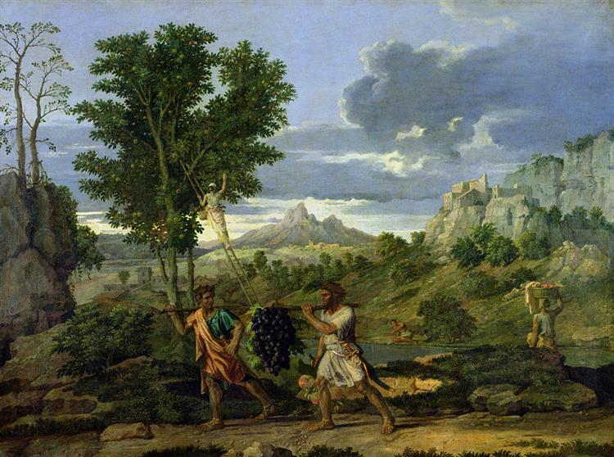
Fear greater than the Fruit (Numbers 13.17-33)
• The path Caleb shows is one of faithfulness. The land is being given to them, so surely, they can take it.
• Despite the tremendous fruit and obvious blessing of being in the land, the people chose instead to fear. They were so focused on the height of the people and the size of the cities, they forgot the wonder of the God who had brought them out of their distress time after time.

Slide 5
A Tree is Known By its Fruit (Matthew 12.33-37 & Luke 6.43-45)
“Either make the tree good and its fruit good, or make the tree bad and its fruit bad, for the tree is known by its fruit. You brood of vipers! How can you speak good, when you are evil? For out of the abundance of the heart the mouth speaks. The good person out of his good treasure brings forth good, and the evil person out of his evil treasure brings forth evil. I tell you, on the day of judgment people will give account for every careless word they speak, for by your words you will be justified, and by your words you will be condemned.”
(Matthew 12:33–37)
“For no good tree bears bad fruit, nor again does a bad tree bear good fruit, for each tree is known by its own fruit. For figs are not gathered from thornbushes, nor are grapes picked from a bramble bush. The good person out of the good treasure of his heart produces good, and the evil person out of his evil treasure produces evil, for out of the abundance of the heart his mouth speaks.”
(Luke 6:43–45)

Slide 6
A Tree is Known By its Fruits (Matthew 12.33-37 & Luke 6.43-45)
Hypocrisy is almost natural to humans – we are actors, able to move in and out of character. Jesus, however, teaches us that good fruit and bad fruit will come from the according trees. Bad fruit is disobedience and good fruit is obedience to Jesus’ words.
Our tongues and actions reveal the horrid brokenness of our souls. Fortunately, Jesus’ perfection can remake us and we can bear good fruit.

Slide 7
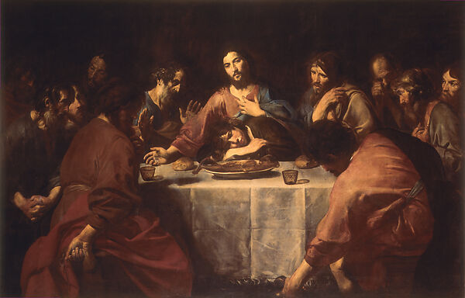
The Fruit of the Vine (Luke 22.14-24)
• The cup of God’s wrath is bitter. It is a judgement that we rightly deserve. Instead of that judgement, because of Jesus’ sacrifice we can experience it as the sweetness of mercy.
• As we partake in the supper of the Lord, it should be a reminder not only of our Lord’s sacrifice, but also the transformation into goodness it inspires.
• “This cup that is poured out for you is the new covenant in my blood.” (Luke 22:20)

Slide 8
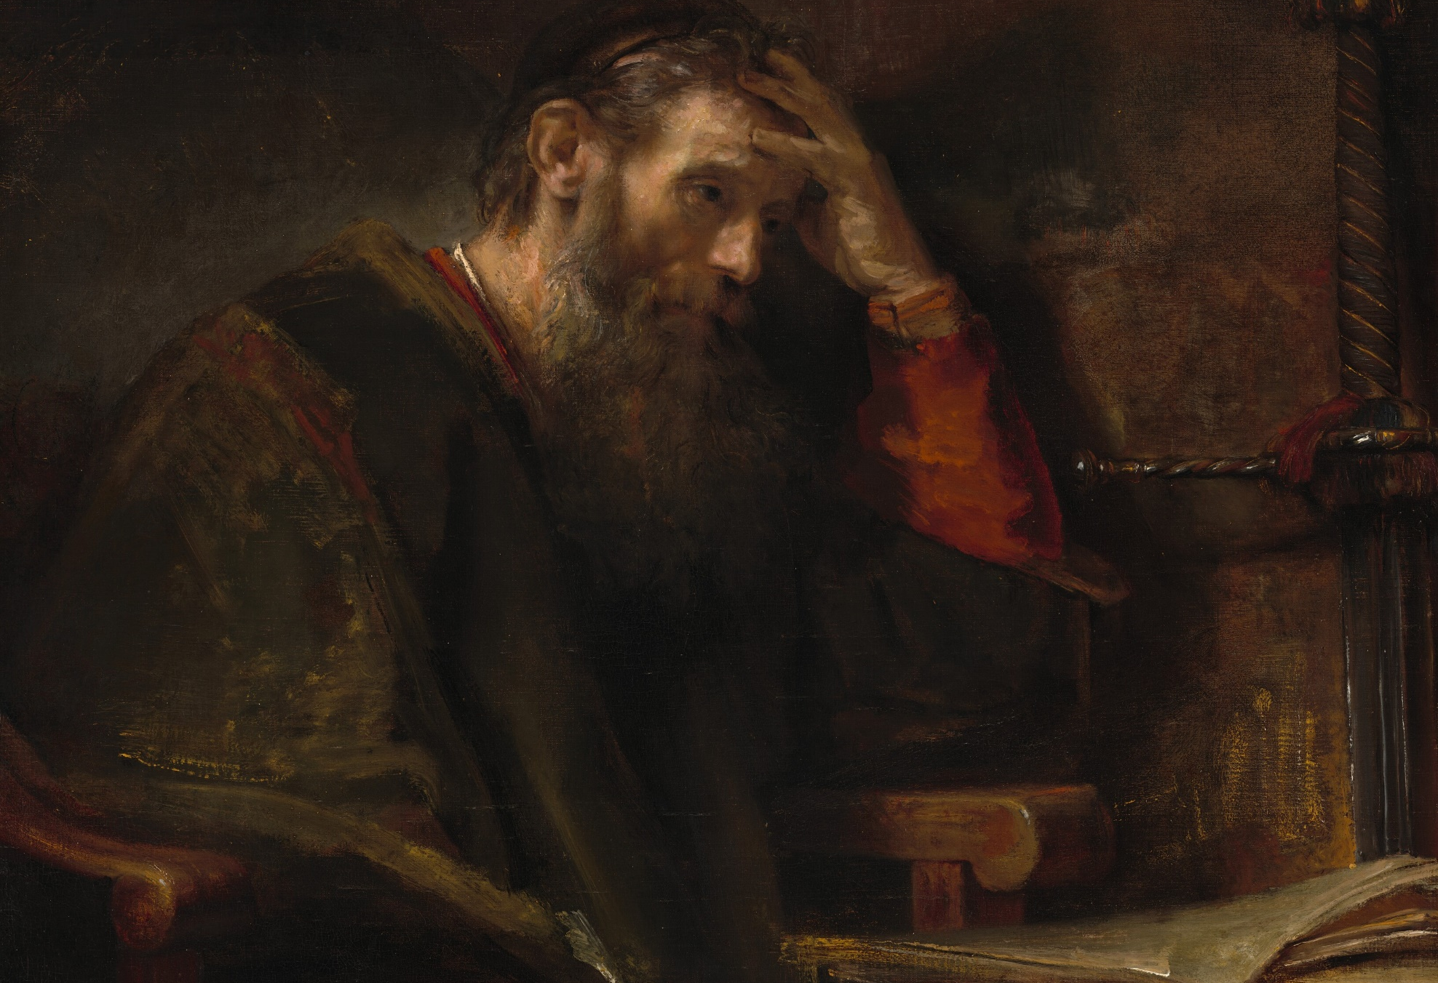
The Righteous Tree (Psalm 1)
The fruit of the flesh is evil, chaotic, and destructive. It has horrific effects on the people around us, but most importantly – “those who do such things will not inherit the kingdom of God.” (Galatians 5:21)
In contrast, the fruit of the Spirit comes because we have crucified our flesh. May we love the one who has blessed us with new life and walk in step with the good name to which we’ve been called. “If we live by the Spirit, let us also keep in step with the Spirit.” (Galatians 5:25)

Slide 9
Application
• Consider your fruit.
Does your life reflect that you have crucified your flesh?
• Take time to be grateful.
Write out and remember the mercies of God.
• Share fruit with those you love.
Share the sweetness and goodness of the God we serve!

