Slide 2
The Christian And AI

Slide 3
Handling our possessions with humility. Genesis 13.1-18
We need to care that our actions reflect with think about God.
We need to care that our actions reflect what we think about other people.
We need to approach every situation with humility.
Faith must undergird all our choices.

Slide 4
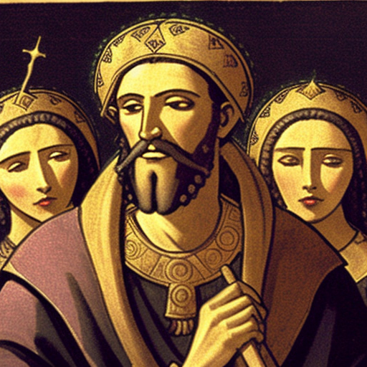
Materials have no morality; our actions do. 1st Kings 7.40-51; 11.1-8
Solomon’s temple is a careful and beautiful piece of art in dedication to the worship of God. All of this effort goes to highlight the beauty of God. Some of those same resources, however, are no doubt used to build idols for the wives of Solomon, and his heart was lead away. The gold wasn’t bad – his heart was.
Whenever we have a tool, such as AI, it can be used for great evil. Instead, we need to use it for helpful, beneficial, and uplifting things.

Slide 5
Where does true wisdom come from? Isaiah 2.1-5
AI is a culmination of mankind’s wisdom – that means that it will be flawed, and it will fall short of true wisdom.
The LORD is a teacher of righteousness (vs. 3), a faithful judge (vs. 4), bringer of peace (vs. 4), and light in the darkness (vs. 5). True wisdom comes from the Mountain of God.

Slide 6
Real relationships, real love, and faithful work. Colossians 3.12-17
No computer can truly take the place of human relationships. We need to make sure our focus is being the type of people to build fruitful relationships and community with.
No computer can truly take the place of human work and creativity. We need to make sure our all is dedicated to showing thankfulness to God through our hard work.
Technology of all sorts can be a great tool. However, from our phones to AI, we must use any resource to ultimately to reveal God’s goodness, righteousness, and holiness.

