Slide 2
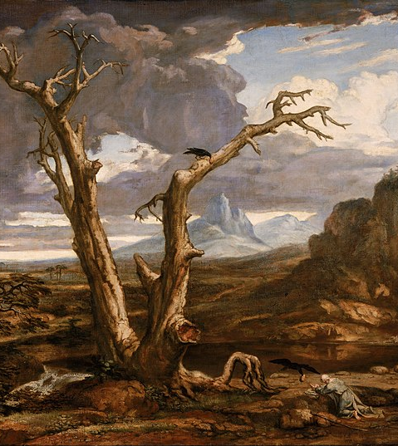
We Feel that We’re Working Alone
The lack of activity on the part of others (real or perceived) has the potential to drag us down.
But if it all rests on your shoulders, is the work not too important for you to give up?

Slide 3
Struggles with Delayed Gratification
People have always struggled with wanting to immediately see the results of their work.
But the work you are doing spans ages.

Slide 4
We Don’t Feel We’re Making a Difference
We can’t always see the impact of our work in the midst of carrying it out.
But we need to remember that our time is being invested into a cause that has already succeeded.

Slide 5
