Slide 1
Sacrifice and Courage
Being Christ’s Ambassadors

Slide 2
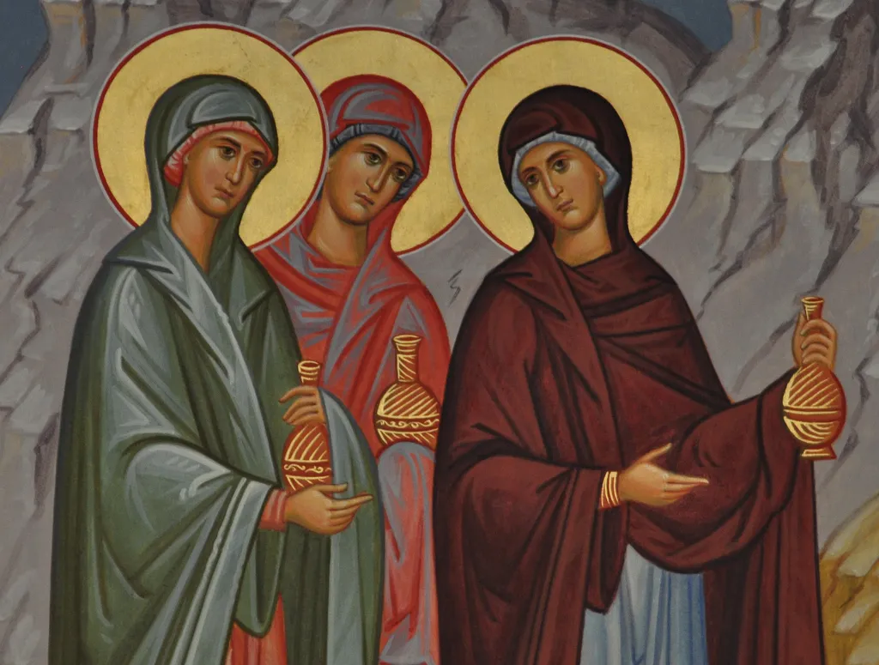
The Day of Preparation (Mark 15.42-16.3)
The “shame” of being associated with Jesus doesn’t phase these disciples. Joseph honors Him on the day of His death. Mary, Mary, and Salome seek to honor Him after the Sabbath.
Does your life for Jesus reflect that He has given you more courage? Has His sacrifice inspired your sacrifice?

Slide 3
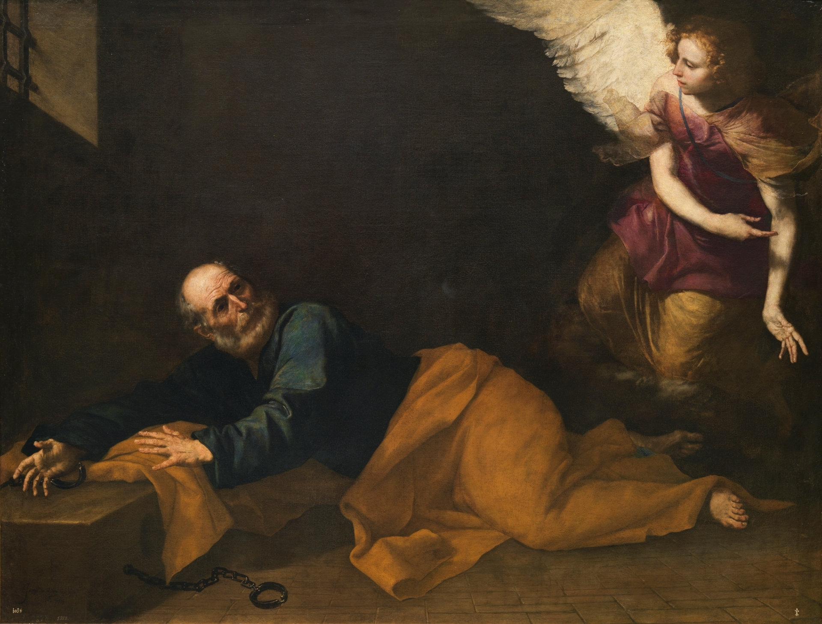
The Unity of the Church (Acts 12.1-19)
Persecution and oppression don’t stop the early church. It drives them to greater unity and strength together.
Does our church reflect this same unity? Are we dedicated to strengthening and caring for God’s family? How could something that means so much to them mean so little to us?

Slide 4
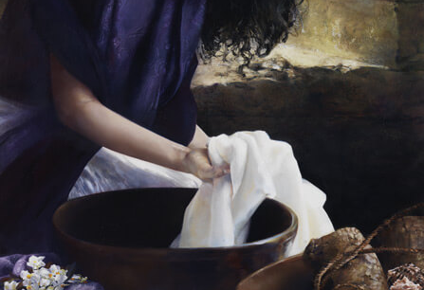
“She prevailed upon them…” (Acts 16.11-15)
Evangelism and hospitality both require our effort. From Paul and Lydia, we learn that in the light of the gospel, what else could we do but live with courage and sacrifice?
If we aren’t defined by those things, do we truly believe the gospel?

Slide 5
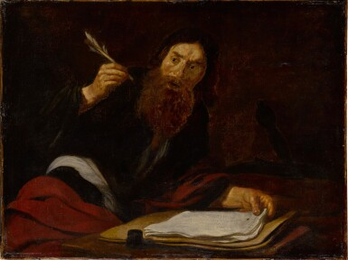
The Ministry of Reconciliation
(2nd Corinthians 5.1-20)
We are ambassadors of Jesus. Living as strangers in a foreign land, brought near by our God, and given a ministry of reconciliation. A true Christian walk is not confined to a building or a time: “So whether we are at home or away, we make it our aim to please him.” (2 Corinthians 5:9)
Do we make it our aim to please Him?

Slide 6
Application
Things that require courage and sacrifice to demonstrate our walk and encourage our congregation:
Time and effort put into personal Bible study and asking good questions.
Reaching out to neighbors to bring the mercy of God near.
Working righteousness for our community and for our local work.

