Slide 1
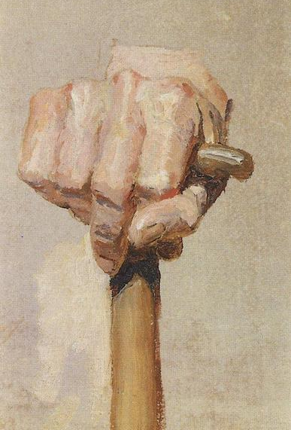
Strengthening Our Hands

Slide 2
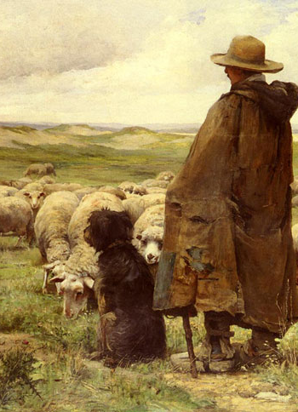
Strengthen Your Elders
These are men that we have selected according to God’s wisdom—they are worthy of our trust, even in difficult times.

Slide 3
Strengthen Your Elders
Recognize that while they are not to “lord it over,” they still hold a position of authority within Christ’s Church.

Slide 4
Strengthen Your Elders
Remember that they are still human, and very well may need words of encouragement and even caution.

Slide 5
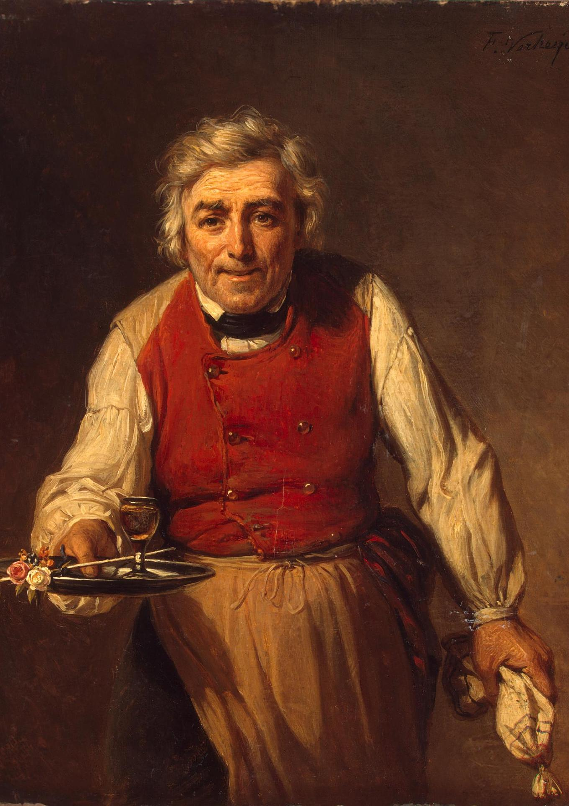
Strengthen Those Who Minister
Hold your deacons to the same level of expectation that is set for them by Scripture—they are not the Junior Varsity Squad.

Slide 6
Strengthen Those Who Minister
View those who teach and preach as being together with you in a joint venture—you are partners in this work.

Slide 7
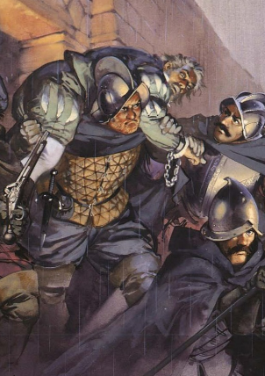
Strengthen The Body
Are you looking to engage in the work alongside others?
Do you seek to alleviate the burdens of others?

Slide 8
Strengthen The Body
Are you helping others to be more involved?
Are you willing to have difficult conversations?

Slide 9
Therefore, comfort one another and build up one another, just as you also are doing. I Thess. 5:11

