Slide 1
Struggling with Confession

Slide 2
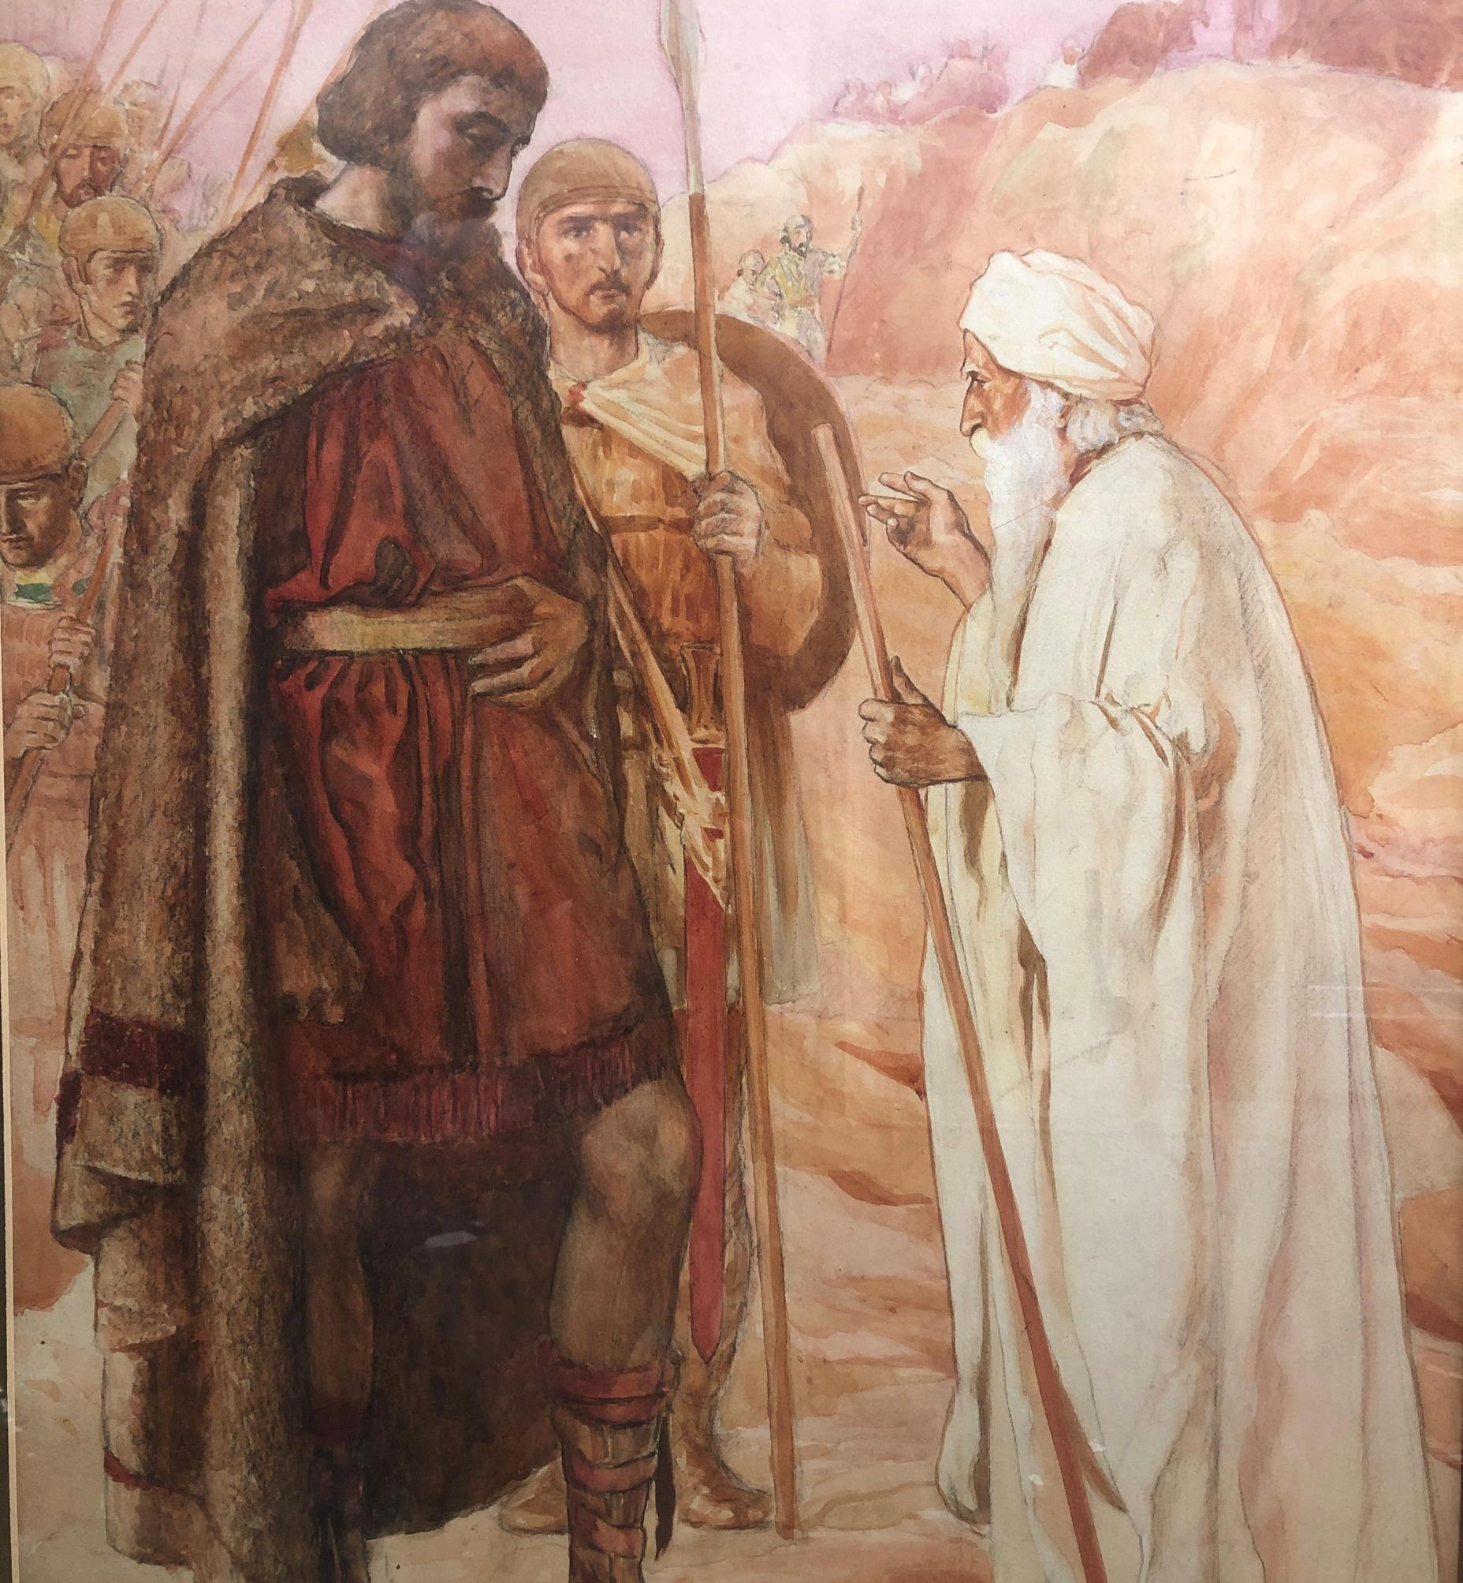
King Saul (1st Samuel 15.1-23)
Saul’s responsibility as a king was to uphold justice, but also lead his people in paths of righteousness. Instead, he chooses to not lead and blame the people for his failures.
To confess well, we must not shirk our responsibility. We must have people who will keep us accountable.

Slide 3
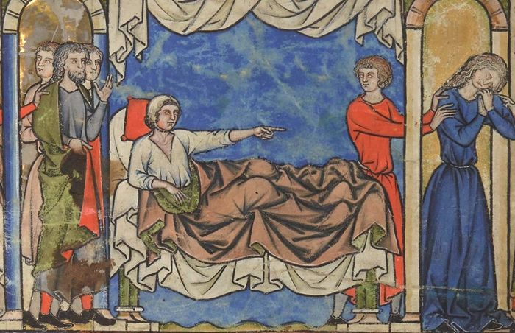
Amnon, Son of King David (2nd Samuel 13.1-22)
Amnon’s story is all about self – mistaking love for lust and having people around him encourage his awful behavior.
Selfishness must be countered by humility. Willing to look inward and understand our shortcomings and need for God’s mercy.

Slide 4
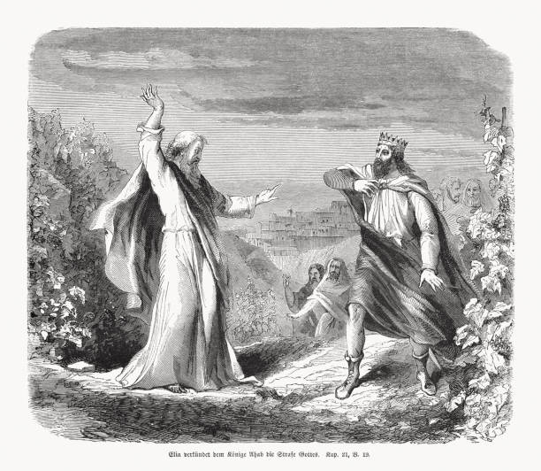
Ahab, King of Israel (1st Kings 18.7-19)
Ahab had brought evil to Israel’s door through his neglecting of commands, destroying God’s prophets, and encouraging rampant idolatry. Yet, he doesn’t see his sin for what it is – he is too prideful to see he is the troubler of Israel.
Pride makes us fools. We must embrace humility so we can confess to our shortcomings.

Slide 5
Application
1. Cultivate an accountability partner and a good friend who will be real with you and challenge you.
2. Read scripture as a wakeup call to you, not a bludgeon for others.
3. Confess to God with true honesty. When you’re honest with Him, you can be honest with others.

