Slide 1
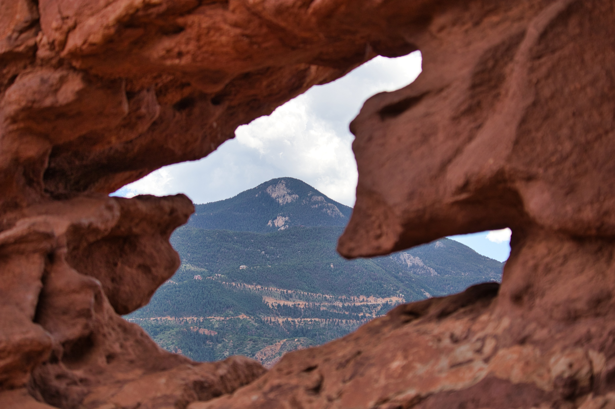

Slide 2
God of the Mountain
What God reveals and what that means for us as followers.

Slide 3
The God of Provision (Genesis 22.1-19)
What We Learn About God:
He is not like other gods. He doesn’t desire the killing of children, but rather the hearts, faith, and obedience of His followers.
He will test our faith. In these moments, He shows that He is trustworthy, and He has good intentions for us.
He richly blesses. This decision by Abraham wouldn’t just benefit him and Isaac, but the whole world. God gives grace upon grace.
What We Learn About Us:
To follow God requires faith. When we see His goodness, all we can do is trust in Him after He shows us, He can be trusted.
Obey what we calls us to do, even when it is difficult. “There would be no sense in saying that you trusted a person if you would not take His advice.”

Slide 4
The God of Holiness (Exodus 19.1-20; Exodus 20.18-21)
What We Learn About God:
He is holy. God is intensely righteous and good. He cannot abide with evil.
He is powerful. Standing in the shadow of Mount Sinai, what they truly feared was a God who could consume the mountain and shake the earth.
He desires a relationship with people. With all His power and gifts, God desires people to love and people who love him back.
What We Learn About Us:
We are not holy. However, through God’s cleansing, He will draw us close.

Slide 5
The God of Steadfast Love (Exodus 34.1-9)
If you have a question about who God is, listen to what He tells you.
What We Learn About God:
He is patient with us. We fall short, but He’s not waiting to get us when we fail.
He loves humans. A part of His character is desiring the best even for those who hate Him.
He will forgive. When God has forgiven you, forgive yourself – you are not greater than Him.
Ho is just. No evil escapes His sight, and He will make all things right.
What We Learn About Us:
Humble yourself. God is far greater than you, and what we should be pursuing His example, not our biased and flawed way of thinking.

Slide 6
God, reveals His power, His goodness, His grace, His justice and His love. As a response, we must follow humbly and faithfully.

