Slide 1
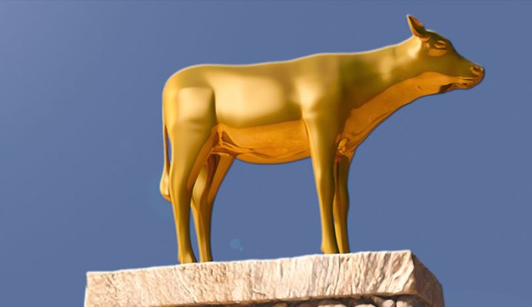
Our Golden Calves
Exodus 32:1-14.

Slide 2
What is Idolatry?

Slide 3
What is Idolatry?
Cambridge Dictionary: “An Object or Picture worshipped as a god.”

Slide 4
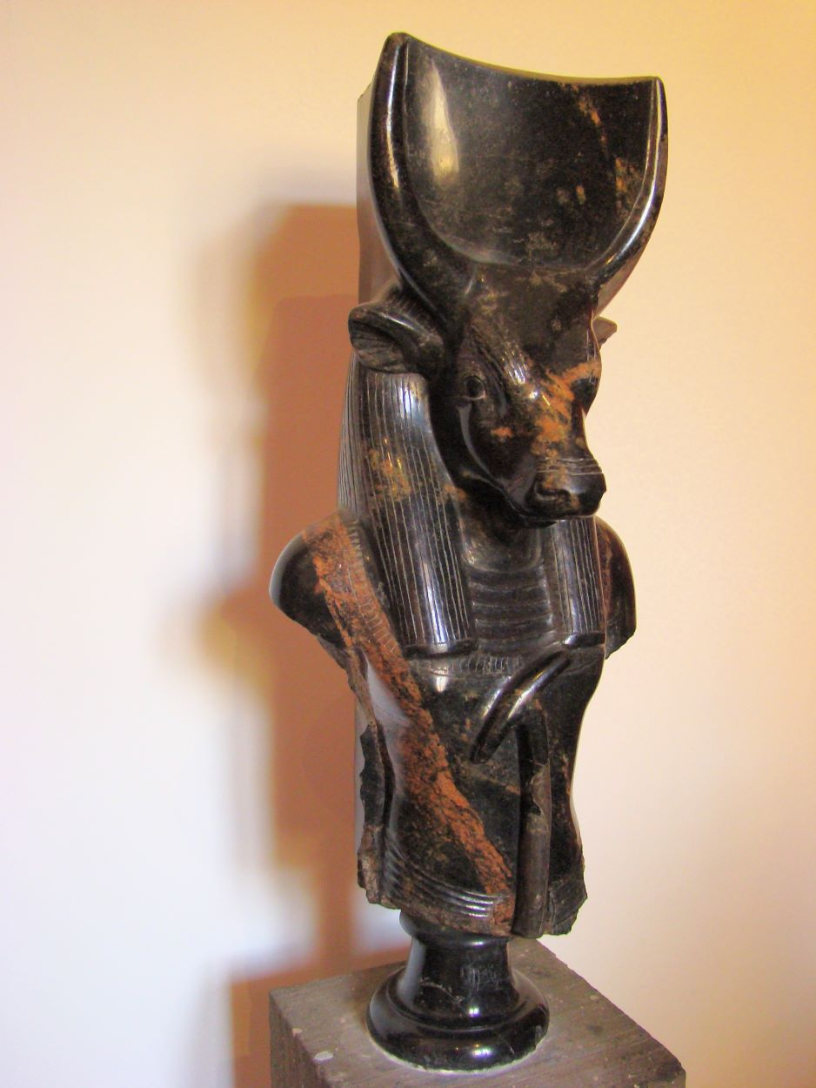
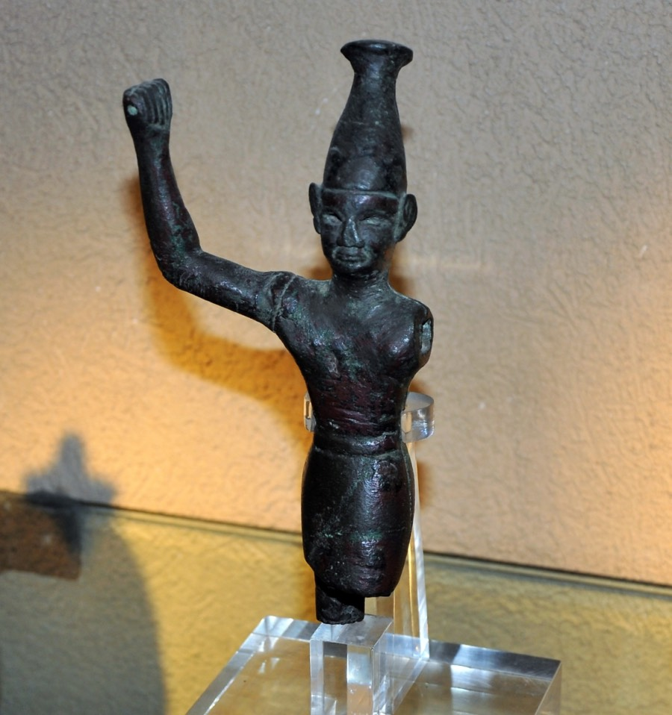
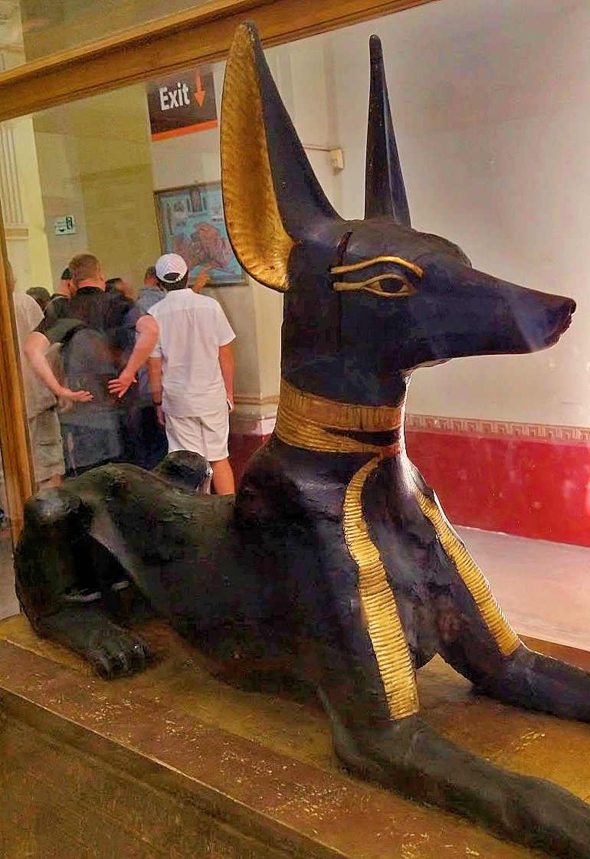
What is Idolatry?
Cambridge Dictionary: “An Object or Picture worshipped as a god.”

Slide 5
What is Idolatry?
The New Century Dictionary: “Also any person or thing that is the object of blind adoration and overflowing devotion.”

Slide 6
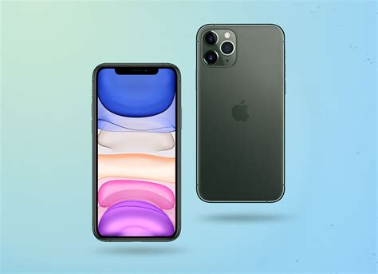
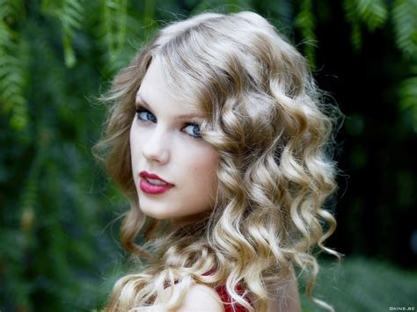
What is Idolatry?
The New Century Dictionary: “Also any person or thing that is the object of blind adoration and overflowing devotion.”

Slide 7
What is Idolatry?
“You shall have no other gods before me.” Exodus 20:3

Slide 8
Our Idols Today:
Work:

Slide 9
Our Idols Today:
Work:
Money: 1 Timothy 6:10

Slide 10
Our Idols Today:
Work:
Money: 1 Timothy 6:10
School:

Slide 11
Our Idols Today:
Work:
Money: 1 Timothy 6:10
School:
Physical appearance:

Slide 12
Our Idols Today:
Work:
Money: 1 Timothy 6:10
School:
Physical appearance:
Identity: Galatians 3:26-29

Slide 13
Our Idols Today:
Work:
Money: 1 Timothy 6:10
School:
Physical appearance:
Identity: Galatians 3:26-29
Sex: 1 Corinthians 6:18-20

Slide 14
Results of Idolatry:
Idolatry creates immorality: Romans 1:21-27

Slide 15
Results of Idolatry:
Immorality: Romans 1:21-27
Death: Romans 1:32; Exodus 32:19-28

Slide 16
How to Avoid Idolatry:

Slide 17
How to Avoid Idolatry:
Examine yourself:
“Examine yourselves as to whether you are in the faith. Test yourselves. Do you not know yourselves, that Jesus Christ is in you?—unless indeed you are disqualified.” 2 Corinthians 13:5

Slide 18
How to Avoid Idolatry:
Examine yourself:
“Examine yourselves as to whether you are in the faith. Test yourselves. Do you not know yourselves, that Jesus Christ is in you?—unless indeed you are disqualified.” 2 Corinthians 13:5
Set Limitations:

Slide 19
How to Avoid Idolatry:
Prioritize the things of God:
“But his delight is in the law of the LORD, and in His law he meditates day and night. He shall be like a tree planted by the rivers of water, that brings forth its fruit in its season, whose leaf also shall not wither; And whatever he does shall prosper.” Psalm 1:2-3

