Slide 1
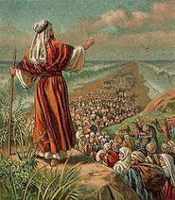
Out of Bondage

Slide 2
Outline
God provides freedom when there is no hope
Obtaining freedom requires action
Appreciation of freedom
Application

Slide 3
God Provides Freedom When There Is No Hope
Exodus 1:8-14: Now there arose a new king over Egypt, who did not know Joseph. And he said to his people, “Behold, the people of Israel are too many and too mighty for us. Come, let us deal shrewdly with them, lest they multiply, and, if war breaks out, they join our enemies and fight against us and escape from the land.” Therefore they set taskmasters over them to afflict them with heavy burdens. They built for Pharaoh store cities, Pithom and Raamses. But the more they were oppressed, the more they multiplied and the more they spread abroad. And the Egyptians were in dread of the people of Israel. So they ruthlessly made the people of Israel work as slaves and made their lives bitter with hard service, in mortar and brick, and in all kinds of work in the field. In all their work they ruthlessly made them work as slaves.

Slide 4
God Provides Freedom When There Is No Hope
Exodus 2:23-25: During those many days the king of Egypt died, and the people of Israel groaned because of their slavery and cried out for help. Their cry for rescue from slavery came up to God. And God heard their groaning, and God remembered his covenant with Abraham, with Isaac, and with Jacob. God saw the people of Israel—and God knew.

Slide 5
God Provides Freedom When There Is No Hope
The World Never Can
Exodus 3:18-19: And they will listen to your voice, and you and the elders of Israel shall go to the king of Egypt and say to him, ‘The Lord, the God of the Hebrews, has met with us; and now, please let us go a three days' journey into the wilderness, that we may sacrifice to the Lord our God.’ But I know that the king of Egypt will not let you go unless compelled by a mighty hand.

Slide 6
God Provides Freedom When There Is No Hope
Freedom In Christ
Acts 13:38-39: Let it be known to you therefore, brothers, that through this man forgiveness of sins is proclaimed to you, and by him everyone who believes is freed from everything from which you could not be freed by the law of Moses.

Slide 7
God Provides Freedom When There Is No Hope
Freedom In Christ
Gal 3:23-29: Now before faith came, we were held captive under the law, imprisoned until the coming faith would be revealed. So then, the law was our guardian until Christ came, in order that we might be justified by faith. But now that faith has come, we are no longer under a guardian, for in Christ Jesus you are all sons of God, through faith. For as many of you as were baptized into Christ have put on Christ. There is neither Jew nor Greek, there is neither slave nor free, there is no male and female, for you are all one in Christ Jesus. And if you are Christ's, then you are Abraham's offspring, heirs according to promise.

Slide 8
God Provides Freedom When There Is No Hope
Part of God’s Judgement
Ex 6:2-6: God spoke to Moses and said to him, “I am the Lord. I appeared to Abraham, to Isaac, and to Jacob, as God Almighty, but by my name the Lord I did not make myself known to them. I also established my covenant with them to give them the land of Canaan, the land in which they lived as sojourners. Moreover, I have heard the groaning of the people of Israel whom the Egyptians hold as slaves, and I have remembered my covenant. Say therefore to the people of Israel, ‘I am the Lord, and I will bring you out from under the burdens of the Egyptians, and I will deliver you from slavery to them, and I will redeem you with an outstretched arm and with great acts of judgment.

Slide 9
God Provides Freedom When There Is No Hope
Part of God’s Judgement
2 Thes 1:5-10: This is evidence of the righteous judgment of God, that you may be considered worthy of the kingdom of God, for which you are also suffering— since indeed God considers it just to repay with affliction those who afflict you, and to grant relief to you who are afflicted as well as to us, when the Lord Jesus is revealed from heaven with his mighty angels in flaming fire, inflicting vengeance on those who do not know God and on those who do not obey the gospel of our Lord Jesus. They will suffer the punishment of eternal destruction, away from the presence of the Lord and from the glory of his might, when he comes on that day to be glorified in his saints, and to be marveled at among all who have believed, because our testimony to you was believed.

Slide 10
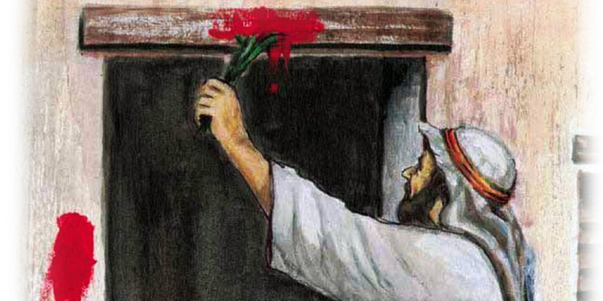
Obtaining Freedom Requires Action
Following God’s Commands
Gen 17:9-14: And God said to Abraham, “As for you, you shall keep my covenant, you and your offspring after you throughout their generations. This is my covenant, which you shall keep, between me and you and your offspring after you: Every male among you shall be circumcised. You shall be circumcised in the flesh of your foreskins, and it shall be a sign of the covenant between me and you. He who is eight days old among you shall be circumcised. Every male throughout your generations, whether born in your house or bought with your money from any foreigner who is not of your offspring, both he who is born in your house and he who is bought with your money, shall surely be circumcised. So shall my covenant be in your flesh an everlasting covenant. Any uncircumcised male who is not circumcised in the flesh of his foreskin shall be cut off from his people; he has broken my covenant.”

Slide 11
Obtaining Freedom Requires Action
Following God’s Commands
Ex 12:12-13: For I will pass through the land of Egypt that night, and I will strike all the firstborn in the land of Egypt, both man and beast; and on all the gods of Egypt I will execute judgments: I am the Lord. The blood shall be a sign for you, on the houses where you are. And when I see the blood, I will pass over you, and no plague will befall you to destroy you, when I strike the land of Egypt.

Slide 12
Obtaining Freedom Requires Action
Following God’s Commands
Col 2:11-15: In him also you were circumcised with a circumcision made without hands, by putting off the body of the flesh, by the circumcision of Christ, having been buried with him in baptism, in which you were also raised with him through faith in the powerful working of God, who raised him from the dead. And you, who were dead in your trespasses and the uncircumcision of your flesh, God made alive together with him, having forgiven us all our trespasses, by canceling the record of debt that stood against us with its legal demands. This he set aside, nailing it to the cross. He disarmed the rulers and authorities and put them to open shame, by triumphing over them in him.

Slide 13
Obtaining Freedom Requires Action
Never Turning Back
Isa 31:1-3: Woe to those who go down to Egypt for help and rely on horses, who trust in chariots because they are many and in horsemen because they are very strong, but do not look to the Holy One of Israel or consult the Lord! And yet he is wise and brings disaster; he does not call back his words, but will arise against the house of the evildoers and against the helpers of those who work iniquity. The Egyptians are man, and not God, and their horses are flesh, and not spirit. When the Lord stretches out his hand, the helper will stumble, and he who is helped will fall, and they will all perish together.

Slide 14
Obtaining Freedom Requires Action
Never Turning Back
Jer 17:5-8: Thus says the Lord: “Cursed is the man who trusts in man and makes flesh his strength, whose heart turns away from the Lord. He is like a shrub in the desert, and shall not see any good come. He shall dwell in the parched places of the wilderness, in an uninhabited salt land.
“Blessed is the man who trusts in the Lord, whose trust is the Lord. He is like a tree planted by water, that sends out its roots by the stream, and does not fear when heat comes, for its leaves remain green, and is not anxious in the year of drought, for it does not cease to bear fruit.”

Slide 15
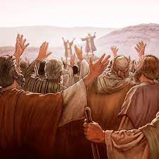
Appreciation of Freedom
Understanding Our Former State
Isa 61:10-11: I will greatly rejoice in the Lord; my soul shall exult in my God, for he has clothed me with the garments of salvation; he has covered me with the robe of righteousness, as a bridegroom decks himself like a priest with a beautiful headdress, and as a bride adorns herself with her jewels. For as the earth brings forth its sprouts, and as a garden causes what is sown in it to sprout up, so the Lord God will cause righteousness and praise to sprout up before all the nations.

Slide 16
Appreciation of Freedom
Humility In Freedom
Num 20:7-12: and the Lord spoke to Moses, saying, “Take the staff, and assemble the congregation, you and Aaron your brother, and tell the rock before their eyes to yield its water. So you shall bring water out of the rock for them and give drink to the congregation and their cattle.” And Moses took the staff from before the Lord, as he commanded him.
Then Moses and Aaron gathered the assembly together before the rock, and he said to them, “Hear now, you rebels: shall we bring water for you out of this rock?” And Moses lifted up his hand and struck the rock with his staff twice, and water came out abundantly, and the congregation drank, and their livestock. And the Lord said to Moses and Aaron, “Because you did not believe in me, to uphold me as holy in the eyes of the people of Israel, therefore you shall not bring this assembly into the land that I have given them.”

Slide 17
Appreciation of Freedom
Humility In Freedom
1 Cor 9:19-23: For though I am free from all, I have made myself a servant to all, that I might win more of them. To the Jews I became as a Jew, in order to win Jews. To those under the law I became as one under the law (though not being myself under the law) that I might win those under the law. To those outside the law I became as one outside the law (not being outside the law of God but under the law of Christ) that I might win those outside the law. To the weak I became weak, that I might win the weak. I have become all things to all people, that by all means I might save some. I do it all for the sake of the gospel, that I may share with them in its blessings.

Slide 18
Appreciation of Freedom
Should Lead Us to Praise
Psalm 142:5-7: I cry to you, O Lord; I say, “You are my refuge, my portion in the land of the living.” Attend to my cry, for I am brought very low! Deliver me from my persecutors, for they are too strong for me! Bring me out of prison, that I may give thanks to your name! The righteous will surround me, for you will deal bountifully with me.

Slide 19
Practical Applications
Consider what we are still clinging to
Share your joy with others
Praise God
Exodus 15:1-18

