Slide 1
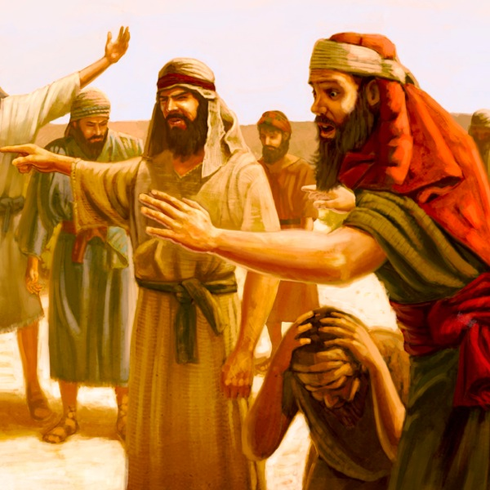
The Sin of Complaining

Slide 2
Why did the Israelites complain?
Disbelief
Exodus 14:8-4
Did not recognize God’s power
Their emotions outweighed their faith
Numbers 14:1-4, 11
Did not believe in His promises

Slide 3
Why did the Israelites complain?
Pride
Numbers 14:2-4; Exodus 16:2-3
Did not understand God’s plan for them
Thought they deserved it easy
Wanted control for themselves

Slide 4
Why did the Israelites complain?
Not content
Numbers 11:1-6
Not satisfied with manna; wanted more
Gave into their desires
Numbers 20:1-5
Never showed any thanks to God

Slide 5
Why did the Israelites complain?
Didn’t ask respectfully
Numbers 20:2-3
Approached God in the wrong way
Exodus 17:1-4, 7
Tested the Lord
Did not wait on God

Slide 6
Seriousness of Complaining
Exodus 16:6-8
God is always listening to our complaints
Numbers 14:20-22
God severely punished the Israelites
Jude 14-16
God’s judgement is the same today

Slide 7
Practical Applications
Obeying Without Complaining
Philippians 2:12-15
Obey no matter the circumstances
Examples
With parents
At jobs
Example of Christ

Slide 8
Practical Applications
Asking for help vs Complaining
Matthew 7:7-11
Ask of God with respectful prayer
Express your needs with a good attitude
James 5:9
Don’t start a culture of complaining
Look for resolutions to the problem

Slide 9
Practical Applications
Be thankful in all circumstances
Philippians 4:11-12
Be slow to complain
Look for the positives
1 Thess. 5:16-18
Take time to thank God for little things

Slide 10
Contentment Leads to Success
1 Timothy 6:6-8
Godliness + Contentment = Great Gain
You’ll live a more positive life
Right in the sight of God
God is going to take care of you

