Slide 1
The Truth of the Law
Matthew 5.13-5.37

Slide 2

Matthew 5.13-16: Salt, Cities, and Light
Jesus illustrates kingdom citizens as physical objects with spiritual reality. The Christian should stand out, even above the nicest and the best.
The motivation is always to point back to God – He is the one who does glory. We do everything out of love for our King.

Slide 3
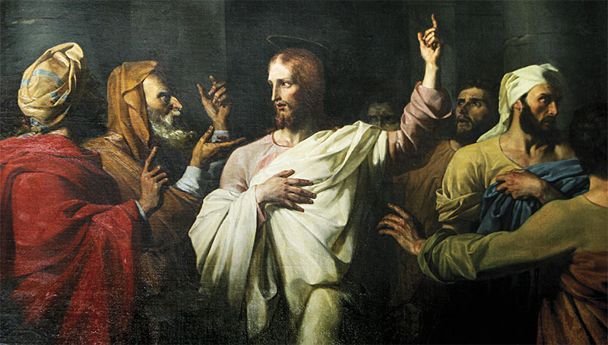
Matthew 5.17-20: Jesus and the Law
The law was not merely “rules”, but also prophetic – it points to the truth found in Christ. When we misread the commands, we’re misunderstanding Jesus.
Following Jesus means both in our hearts and actions – a combination that reveals that we’re citizens of the kingdom.

Slide 4

Matthew 5.21-26:
On Anger
Murder is wrong. But Jesus teaches that the true violation starts with hatred.
Angry mocking is not simply “joking.” It’s evil.
The Christian ought to not “cover up” sin, but to make it right, as soon as possible.

Slide 5
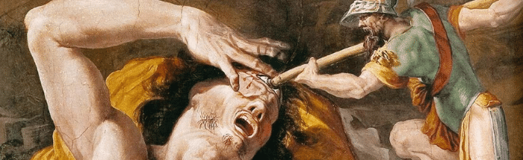
Matthew 5.27-30:
On Lust
The problem of adultery begins when you treat humans made in the image of God as property or things – not humans.
To be separated from God is awful. Instead, be willing to cut off every weight to be with Christ.

Slide 6
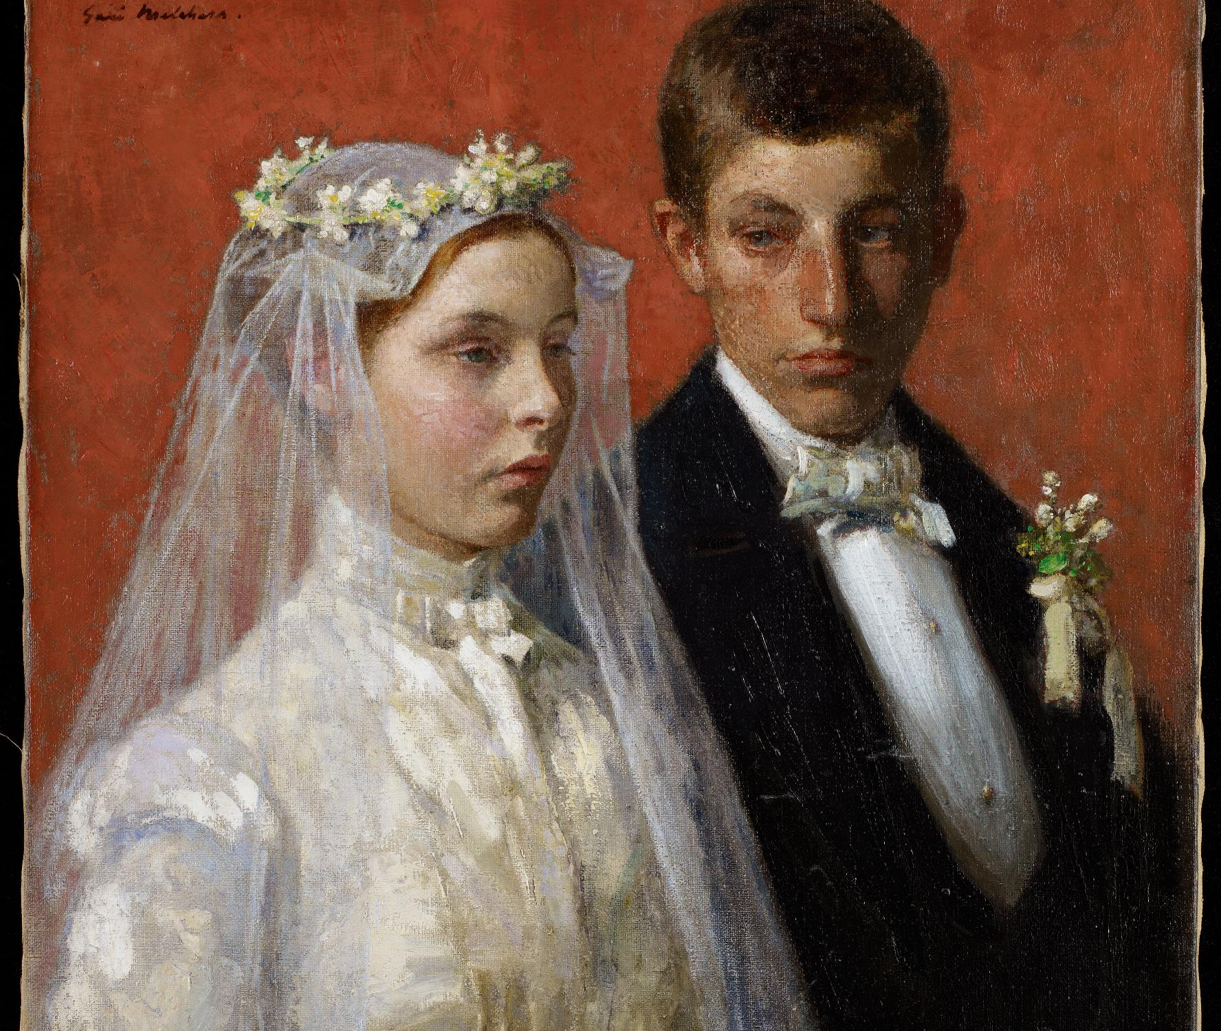
Matthew 5.31-32:
On Divorce
• Divorce in the Mosaic covenant was because of their “hardness of heart”. (Matthew 19) It had clearly been abused and taught that you could merely leave just by getting a paper signed.
• Jesus is actually being more stringent – divorce is strictly in the case of sexual immorality. And that adultery will spread – a sin that will corrupt others. We need to take the marriage covenant strictly.

Slide 7
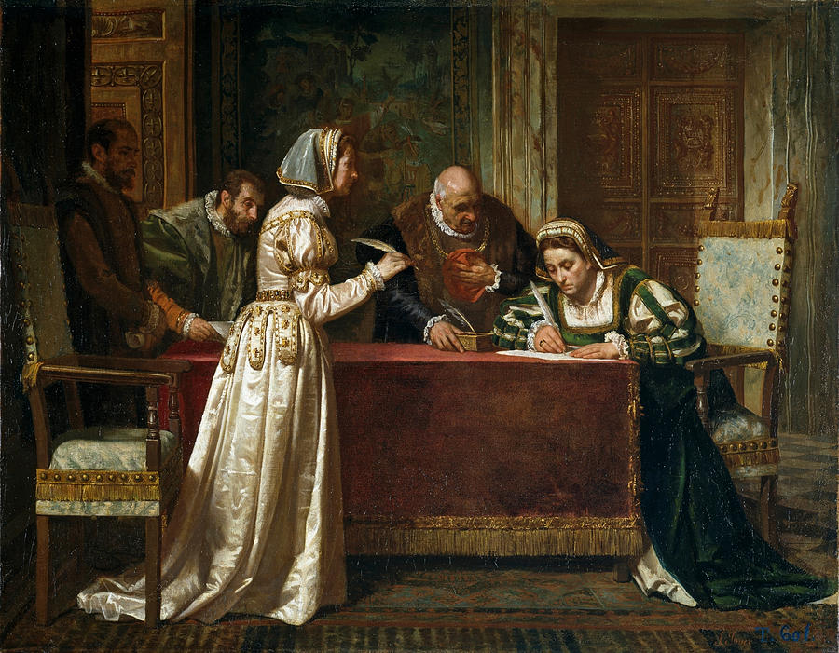
Matthew 5.31-32:
On Oaths
• If your personal conscience doesn’t allow you to make promises or take oaths, don’t listen to me. 😊
• We see, even in the Biblical text, that people were abusing “oaths”. (“And you say, ‘If anyone swears by the altar, it is nothing, but if anyone swears by the gift that is on the altar, he is bound by his oath.’ You blind men! For which is greater, the gift or the altar that makes the gift sacred?” - Matthew 23.18-29) You can make a promise, but it only applies if you make an oath on “x”. Jesus instead insists – to be a kingdom citizen means that you should be truthful. God is truthful, and if we are imitators of Him, we must honor him with truthfulness

Slide 8
Meditation
What we learn about God: His rules are strict, not because He’s looking to get us. Rather, it is because He is good and to dwell with Him, He must pursue His goodness.
What we learn about kingdom citizenship: Comparison to the rest of our society is nonsense. Instead, we are held to a higher standard, and we must listen to our king rather than society and our own hearts.
What we learn about our lives in the world: We should be living examples of the goodness, truthfulness, and grace of our God. Are you salt and light?

