Slide 1
Who Will You Trust?
Matthew 6.19-34

Slide 2
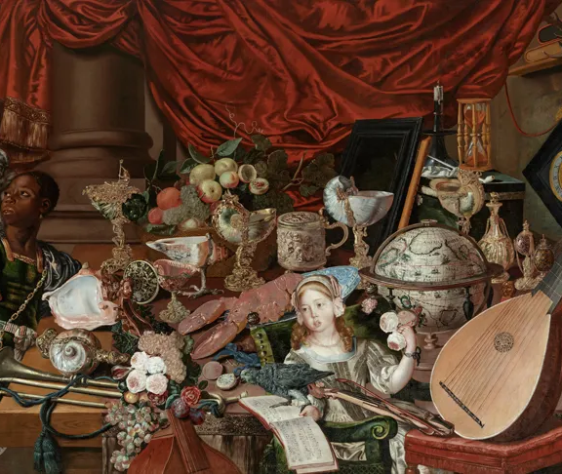
Matthew 6.19-21: Permanent Treasure
Jesus is always seeking to draw us closer to reality and truth.
Money lies – it claims it can fill our lives with hope, comfort, and happiness, but it can’t deliver on its promises.
On the other hand, in the pursuit of the Lord, we’ll have treasure that can’t fail.

Slide 3
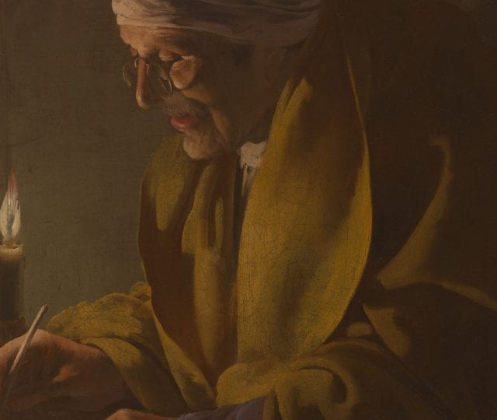
Matthew 6.22-24: No Such Thing As Two Masters
In relationship to God, we either in or out. We either choose to serve Him or we choose rebel against Him.
If we want to be full of light, we need to have our eyes on Jesus, We need to reject the darkness.

Slide 4
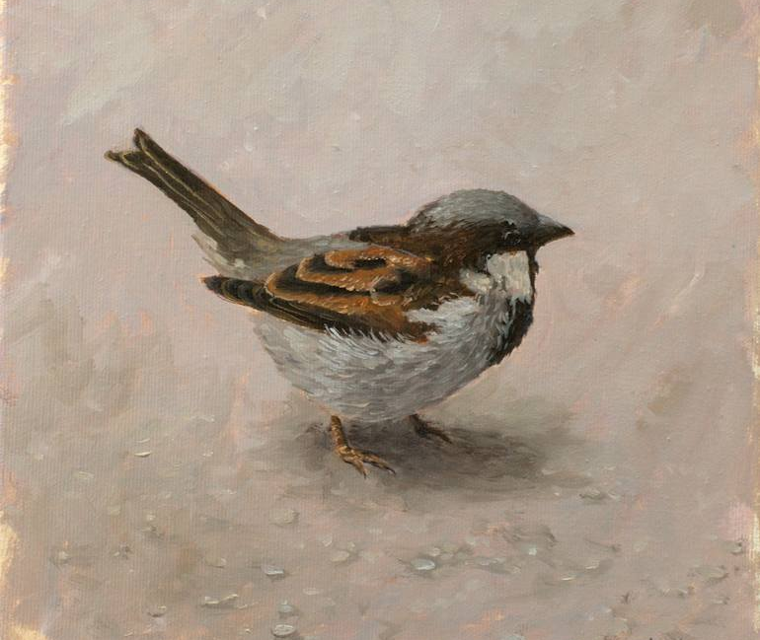
Matthew 6.25-30: On Worry and Anxiety
“Therefore I tell you, do not be anxious about your life, what you will eat or what you will drink, nor about your body, what you will put on. Is not life more than food, and the body more than clothing?”
True life is found, not through anxiety, but through faith.

Slide 5

Matthew 6.31-34:
“Sufficient for the day is its own trouble…”
When we speak to the Father and ask Him, He both is aware of our plight and cares for our state. But we must seek first the kingdom of heaven.
Have faith in the one who holds tomorrow.

Slide 6
Meditation
What we learn about God: God values you and cares for you dearly. Knowing how much God values us means we should trust Him.
What we learn about kingdom citizenship: We are not to be people of complaint or worry, but instead people of trust. We are to be wholly devoted and to “seek first the kingdom”.
What we learn about our lives in the world: The world has no hope. There are a lot of people who are constantly worried. So, for us, we can show them a better way through faith in the permanent king of kings.

