Slide 1
A Call for Consistency
Matthew 7.1-12

Slide 2
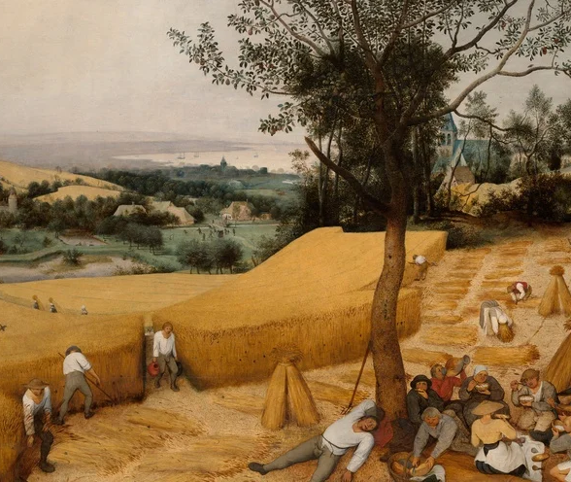
Matthew 7.1-2 – Sowing and Reaping
“Judge not” can be misunderstood, usually based on failing to understand Jesus.
To follow Jesus means we must understand judgement and discernment is based on the standards of Jesus, not our own.

Slide 3
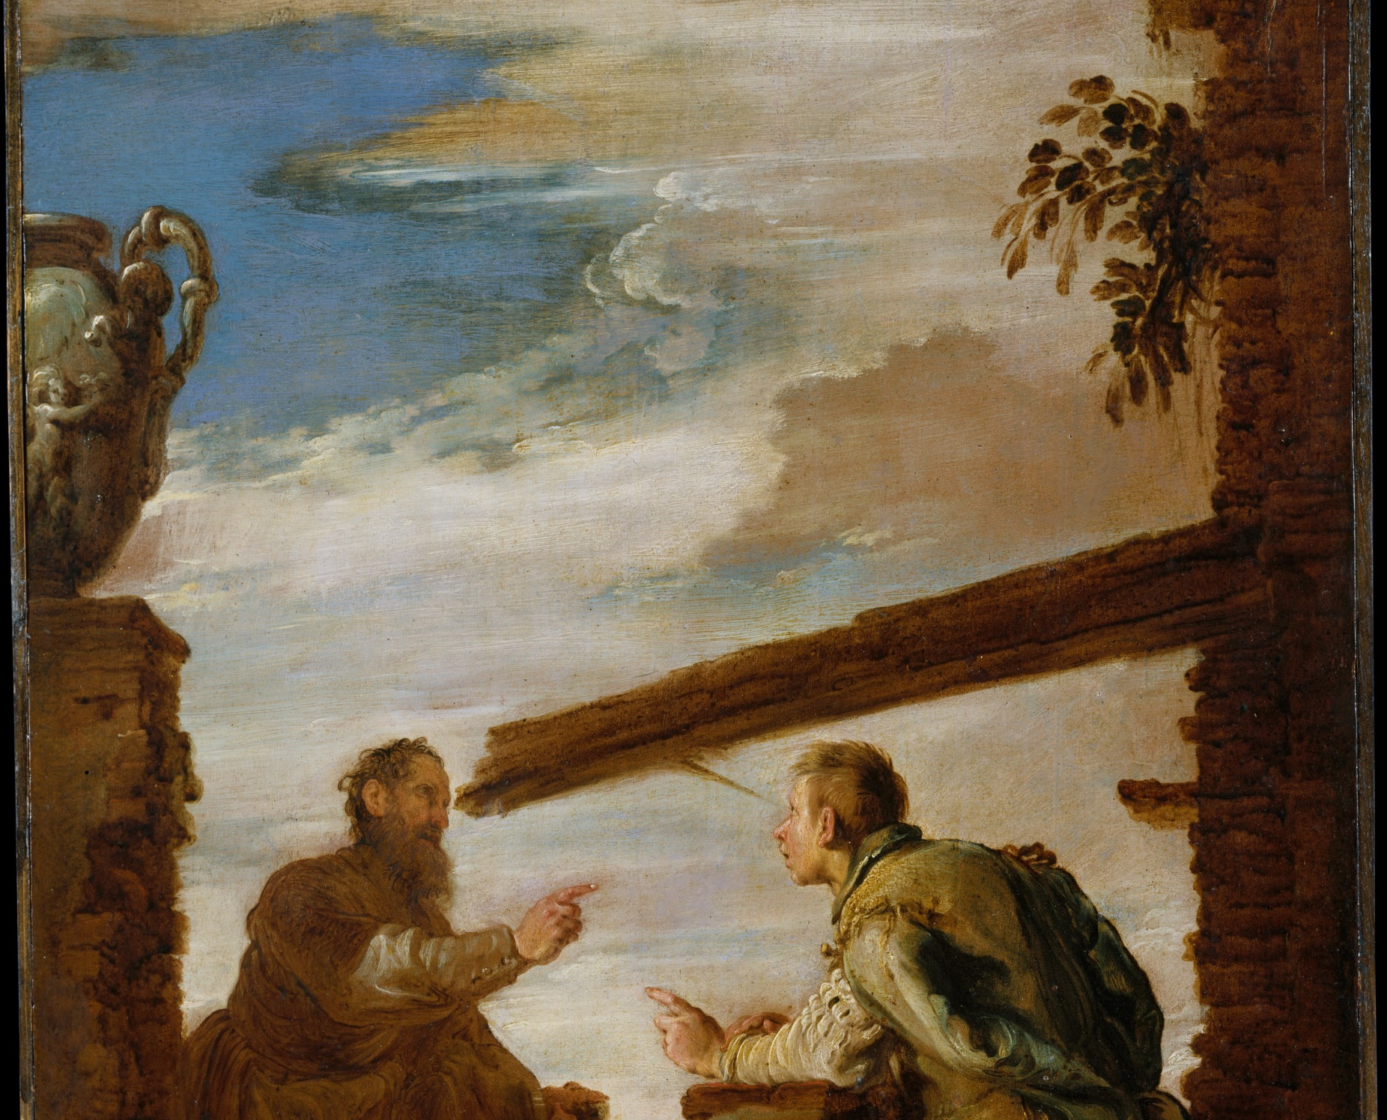
Matthew 7.3-5 – Mercy Triumphs
You will see your own sins and vices more clearly in the people around you. This calls for discernment.
To be a fair person, it takes introspection. How can we judge fairly and mercifully if we can’t understand our own shortcomings?

Slide 4
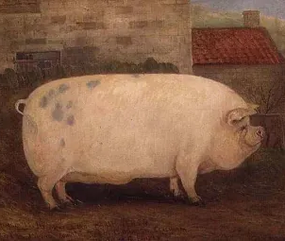
Matthew 7.6 – The Holy and the Profane
We have limitations. In our time, energy, and emotional ability. All of these things are sacred because of our relationship with God. Therefore, sometimes we have to cut somethings off so that we can help others things to grow and thrive.

Slide 5
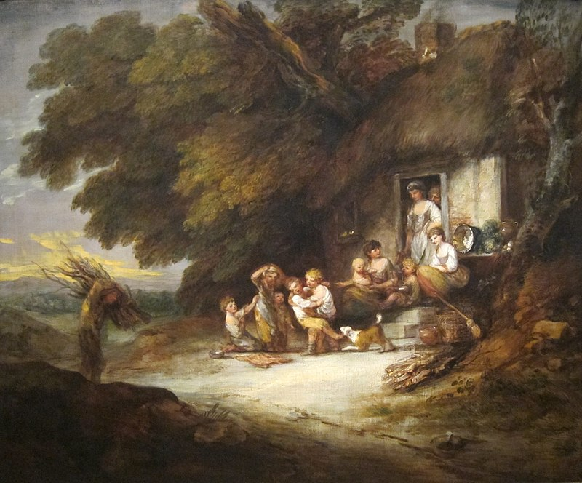
Matthew 7.7-11: Ask, Seek, and Knock
One of the things that should be comforting to us all is that God is never too far away.
On top of that, He cares for us. It doesn’t mean suffering won’t happen, but we have incredible hope through whatever we’re struggling with.

Slide 6
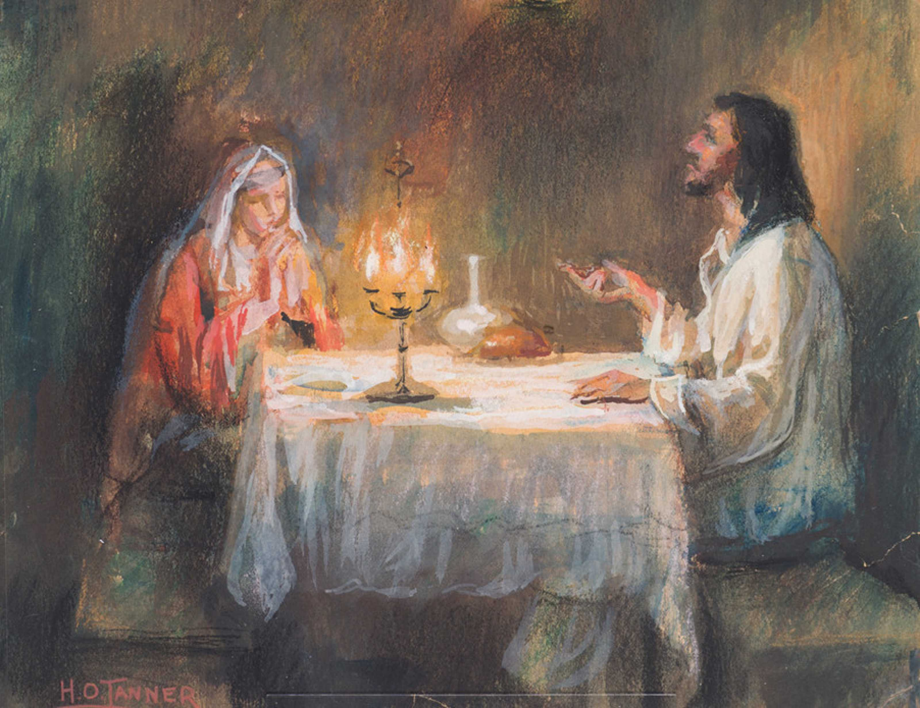
Matthew 7.12 – The Golden Rule
“Do unto others as you would have them do unto you.” How have you limited this command in your life?
We can confidently treat all people well knowing that God is our hope at the end.

Slide 7
Meditation
What we learn about God: God is willing to give us what we need. He is always near at hand to bless. We need to trust in His plan, even in difficulty.
What we learn about kingdom citizenship: We need to be empathetic people. If we were hurting spiritually or physically, we’d want help. That’s how we should seek to help others.
What we learn about our lives in the world: We are discern, not employ prejudice. We are to show love to all and prayerfully, God will bring them to salvation.

