Slide 1
Will You Trust In What God Provides?
The story of Adam and Eve Revisited

Slide 2
Three Questions to Be Answered:
Were Adam and Eve punished simply for eating fruit?
Did God put Adam and Eve in a death trap?
What are we supposed to understand from this story?

Slide 3
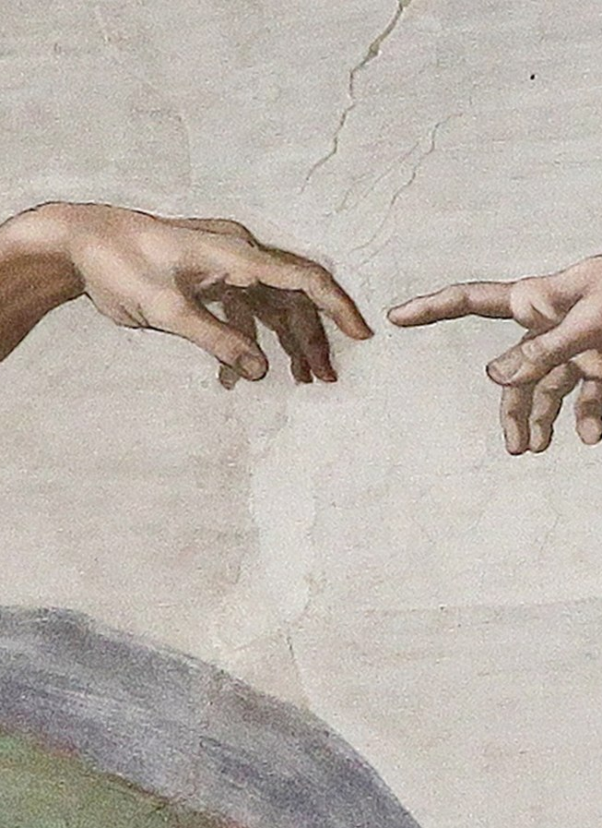
Genesis 2.15-25: The Beauty of Eden
Everything about this passage screams of God’s dedication to humanities’ flourishing:
  Given a job to do. (vs. 15, 19)
  Given companionship with another human. (vs 18, 21-24)
  Dignity Being Reinforced. (vs. 25)
  Given plenty. (vs. 16)
  Given a rule for man’s protection. (vs. 17)
Adam and Eve are united in the love of God, service of one another, and purposeful responsibility. This is paradise.

Slide 4
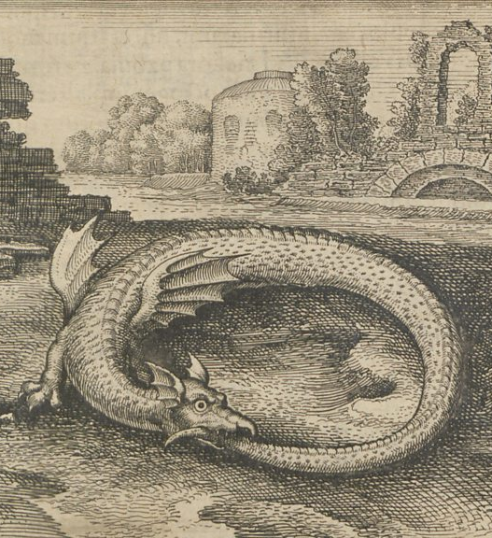
Genesis 3.1-9:
The Deception of the Serpent
God have given His creatures the opportunity to do well with their gifts. The devil in the serpent chose to use his craftiness for deception.
Eve’s response to the snake shows that Adam had failed to properly encourage and teach his wife. The serpent realizes this and strikes with two big deceptions of sin:
  Wouldn’t it be better if you were God?
  What is God hiding from you?
If they looked around, they would know that God had done everything to have a relationship with them and provide for them. Why would He abandon them now?

Slide 5
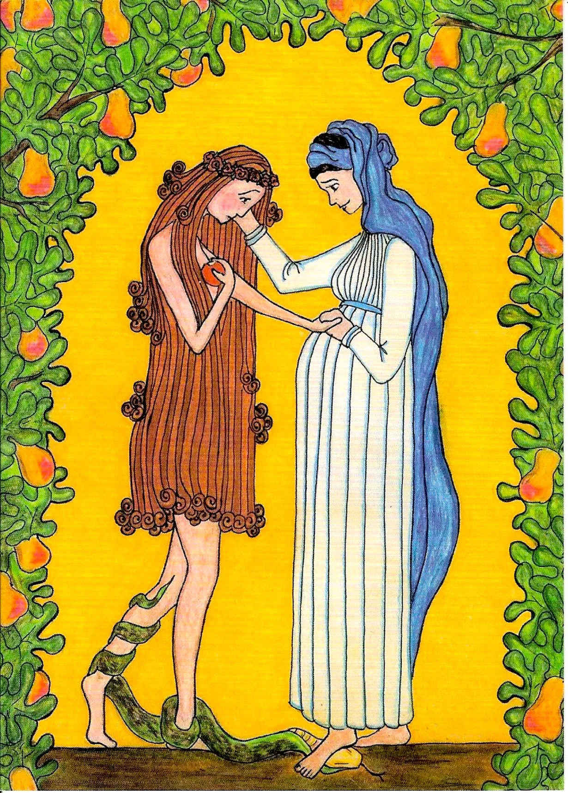
Genesis 3.10-24:
The Curse of Sin
The shame of sin usually doesn’t drive us to accountability. We insist either that we weren’t wrong, or we blame someone else for why we failed.
In the curse of the serpent, we have our hope. That there is coming a day where there will be a snake crusher, the seed of woman, Jesus will humiliate sin, death, and the devil and set us free from these curses. But it doesn’t mean that the curses are healed now.
Sin leads to pain, distrust, shame, and death. The only one who gives us hope is Christ.

Slide 6
In Conclusion
Were Adam and Eve punished for eating fruit? They were punished for faithlessness. God had provided everything; they were foolishly looking for some good outside of Him.
Did God set this up as a death trap? God did see the fall coming. But clearly in the beauty of the gospel and what His plans for transforming man were, He say this as worthwhile.
Why is this story important for us? Sin deceives us and claims God is hiding some good from us. It claims if we’re “gods” it will be better. Instead, we should trust in God’s blessing and provision.
In your battle against sin, be grateful for what you have and remember Jesus’ redemptive love.

