Slide 1
Amazing Grace: Sermon & Song
“‘Tis grace has brought me safe thus far, and grace will lead me home.”

Slide 2
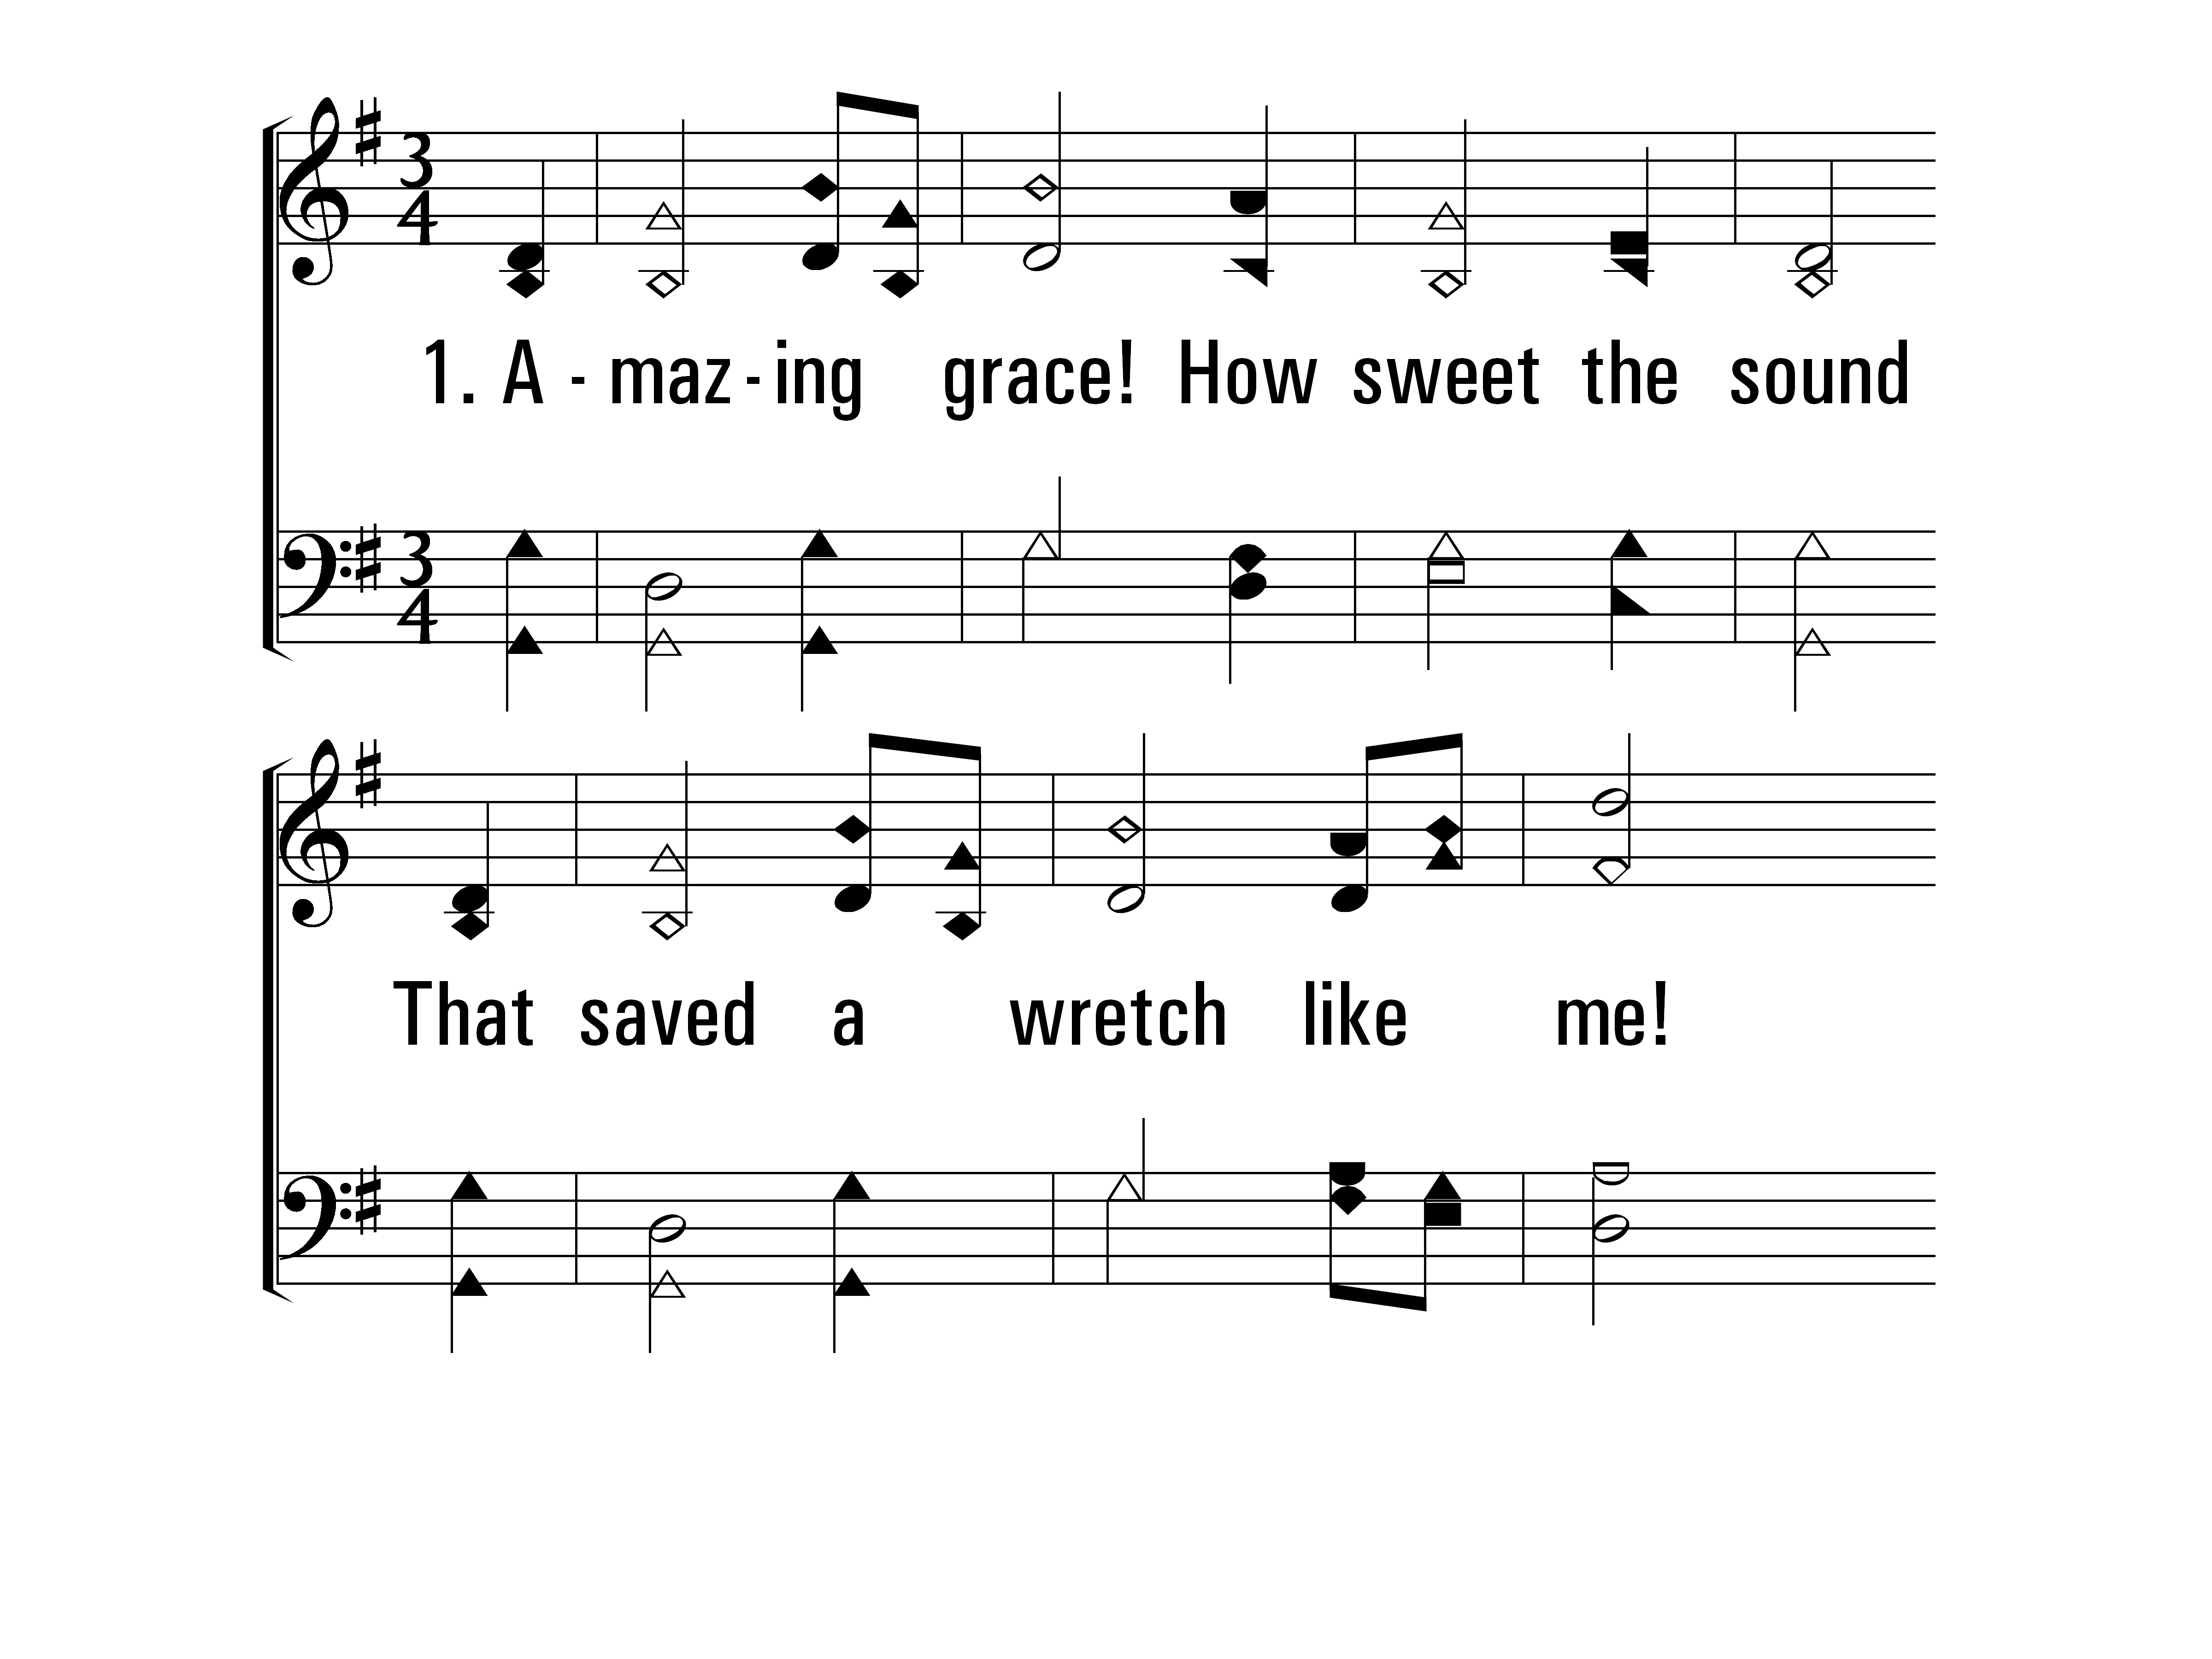
AmazingGrace_st1_a
Vs 1
© 2014 Sumphonia Productions, LLC

Slide 3
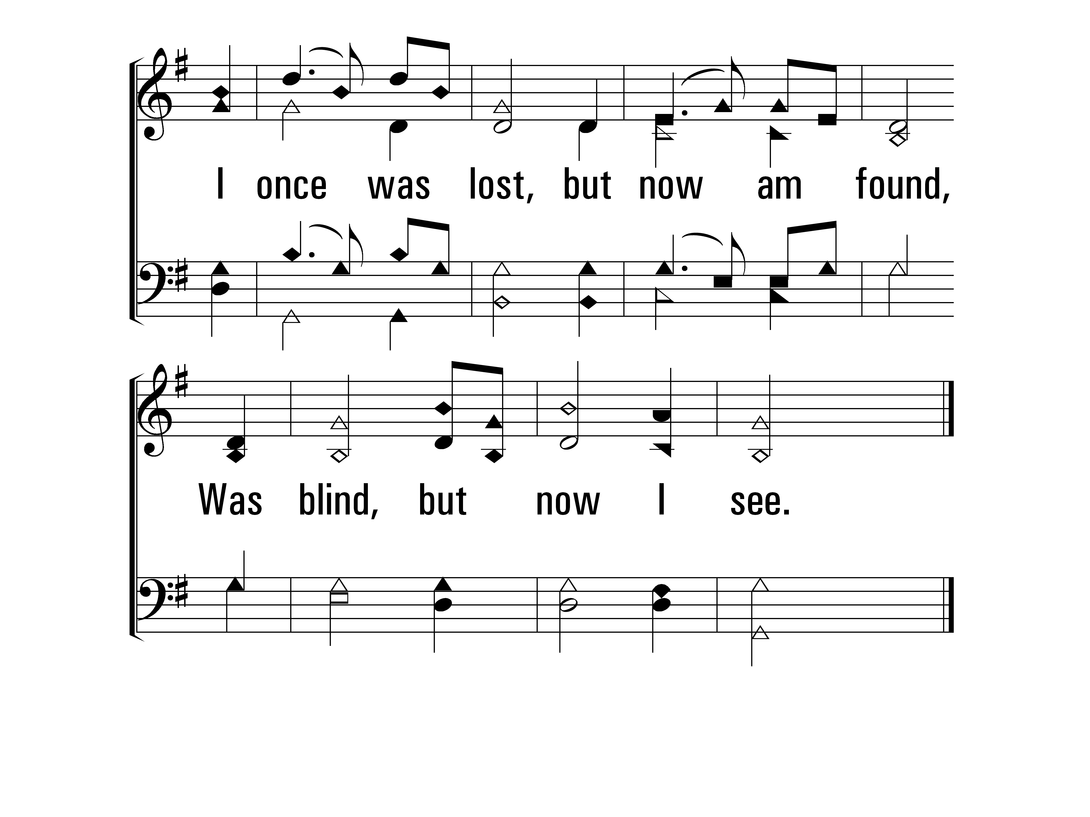
AmazingGrace_st1_b
Vs 1
© 2014 Sumphonia Productions, LLC

Slide 4
AmazingGrace_st2_a
Vs 2
© 2014 Sumphonia Productions, LLC

Slide 5
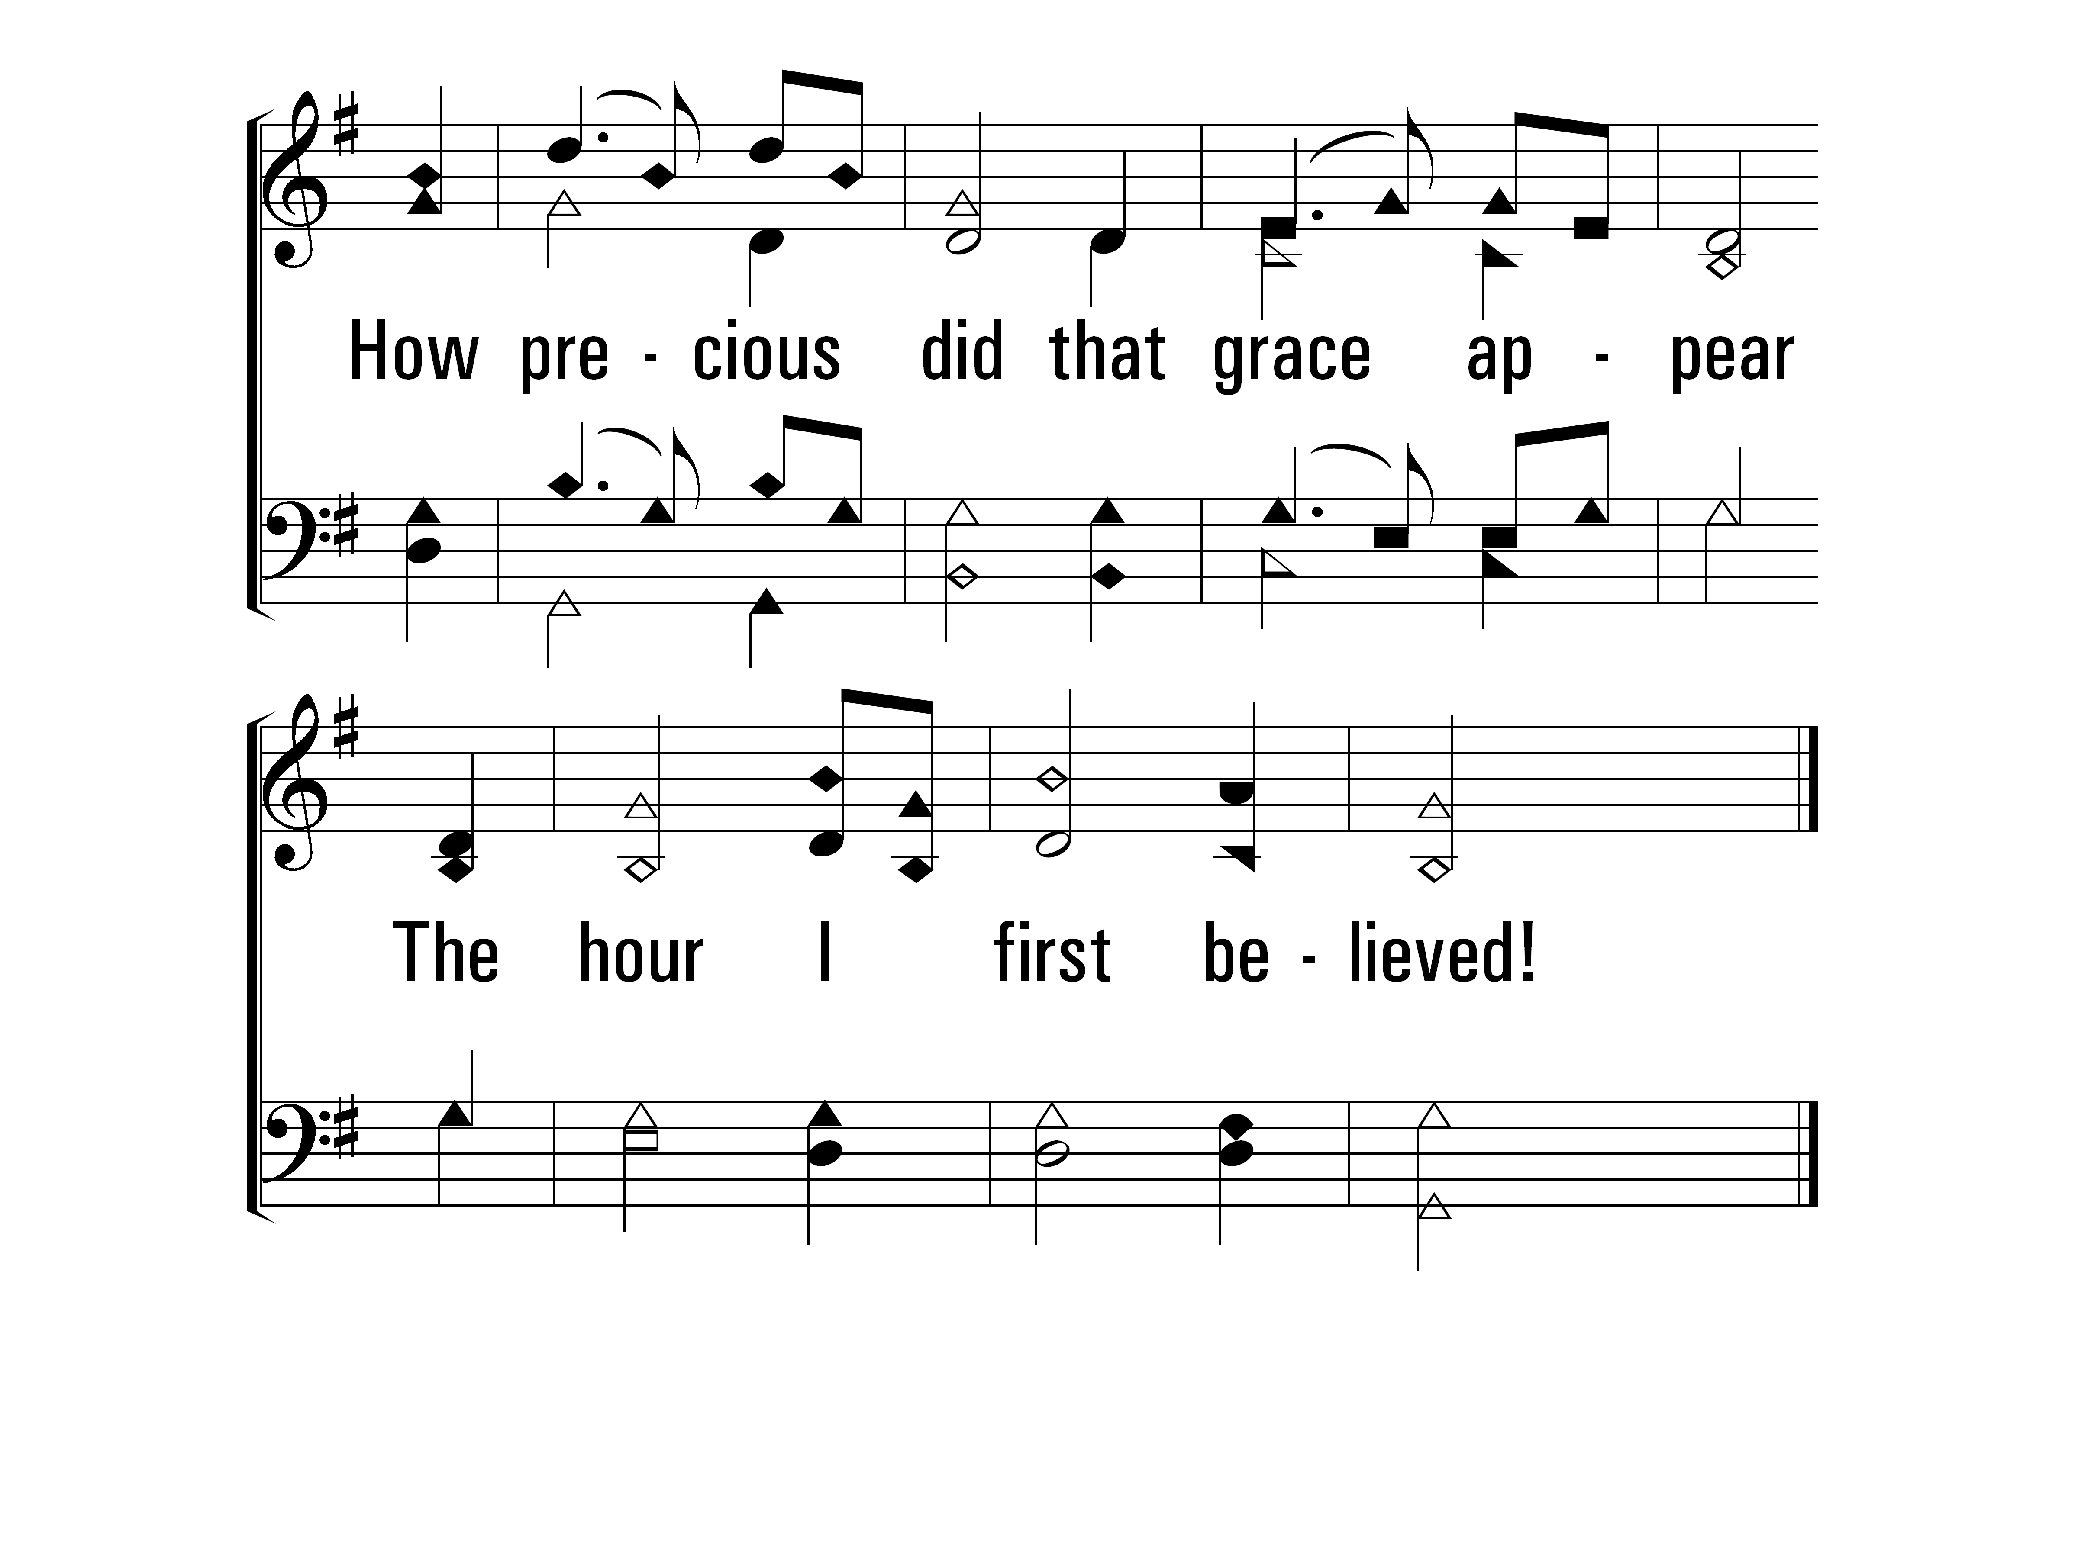
AmazingGrace_st2_b
Vs 2
© 2014 Sumphonia Productions, LLC

Slide 6
“How Sweet the Sound” Luke 7.36-50
Grace begins when we understand we are unworthy of God’s gifts.
Simon didn’t see himself as needing grace, and therefore looked down on her righteous action.
Once we receive grace, it should lead us to service: firstly of God, then of our neighbor.

Slide 7
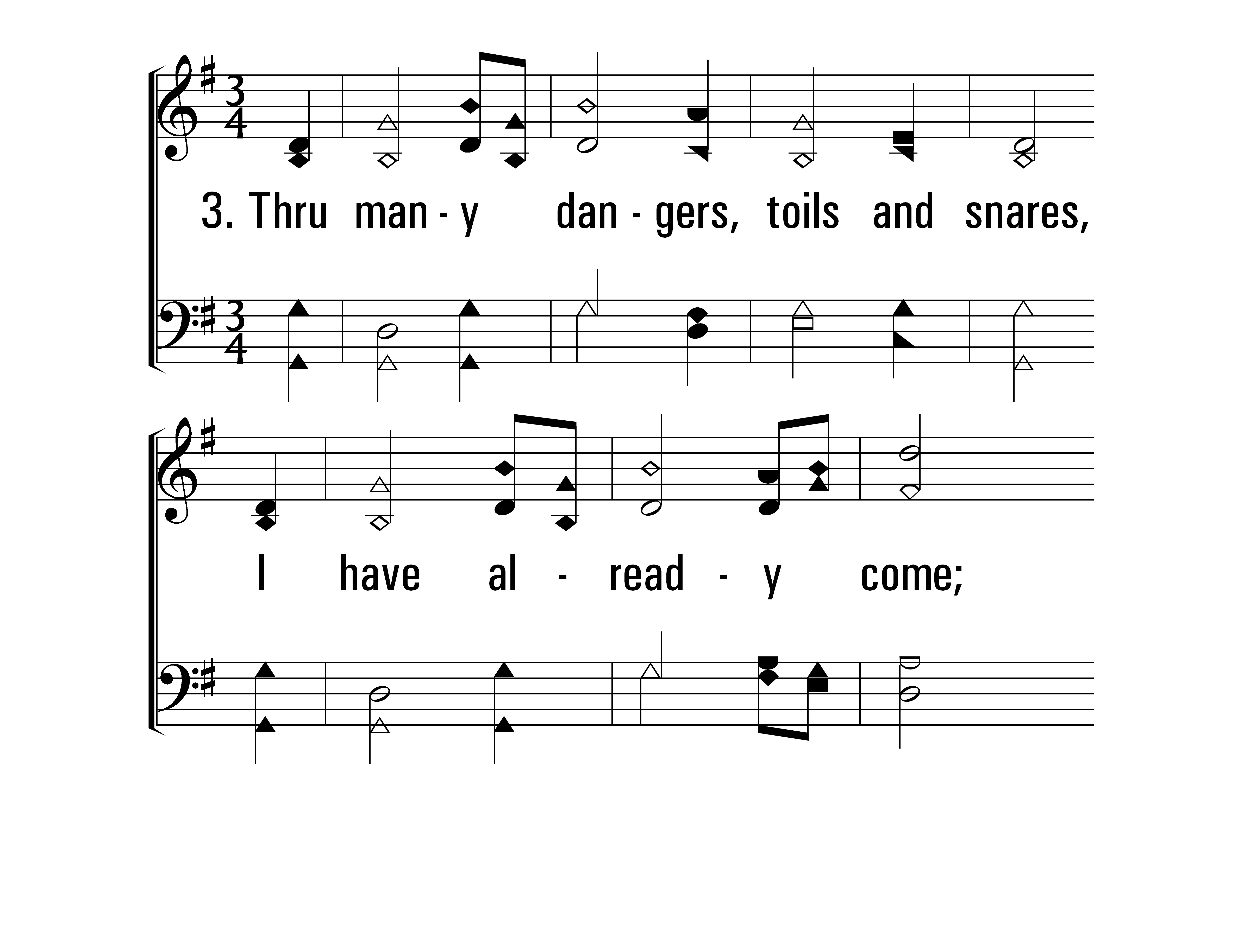
AmazingGrace_st3_a
Vs 3
© 2014 Sumphonia Productions, LLC

Slide 8
AmazingGrace_st3_b
Vs 3
© 2014 Sumphonia Productions, LLC

Slide 9
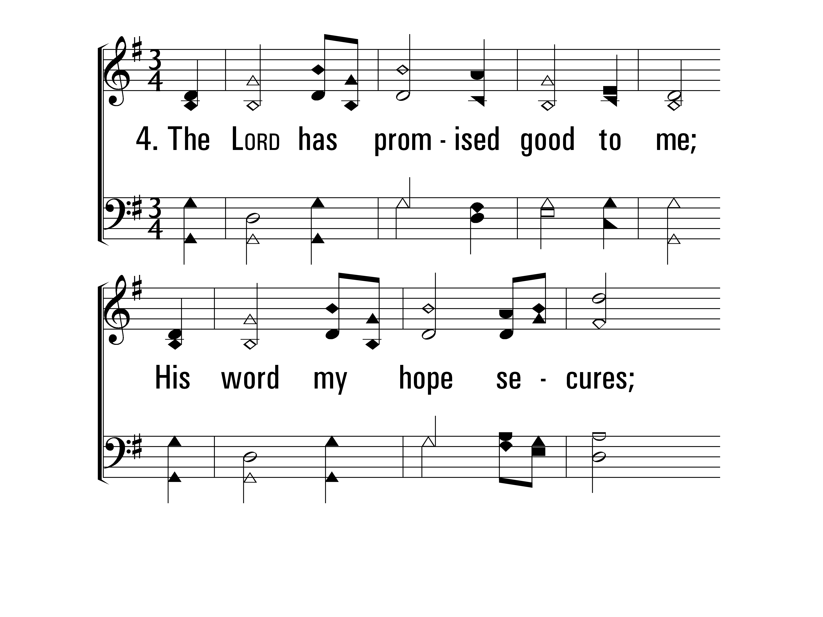
AmazingGrace_st4_a
Vs 4
© 2014 Sumphonia Productions, LLC

Slide 10
AmazingGrace_st4_b
Vs 4
© 2014 Sumphonia Productions, LLC

Slide 11
“His word my hope secures…” Romans 8.31-39
If God is for us, who can be against us? Grace gives us an undying hope!
Jesus died on our behalf so that no accusation will stand if we are joined to Him.
Christians will suffer. However, there is nothing in the entirety of creation than can separate us from the love of God! Our imperfections and sufferings don’t stop God’s grace.

Slide 12
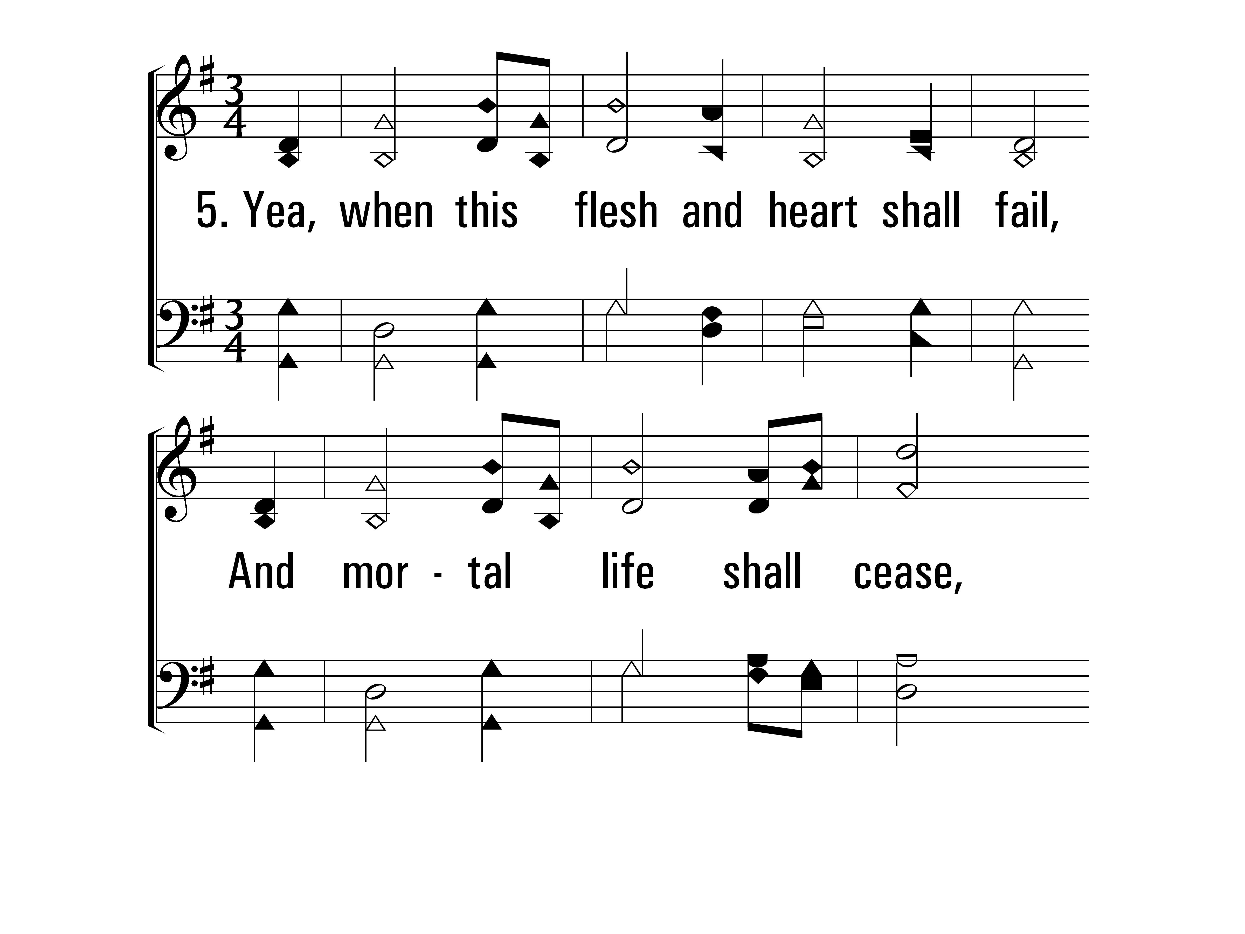
AmazingGrace_st5_a
Vs 5
© 2014 Sumphonia Productions, LLC

Slide 13
AmazingGrace_st5_b
Vs 5
© 2014 Sumphonia Productions, LLC

Slide 14
AmazingGrace_st6_a
Vs 6
© 2014 Sumphonia Productions, LLC

Slide 15
AmazingGrace_st6_b
Vs 6
© 2014 Sumphonia Productions, LLC
End

Slide 16
“A life of joy and peace…” 2nd Corinthians 4.7-18
Our weaknesses actually point to the greatness of the message God has given to us!
The grace of Jesus is not limited, but it will spread to more and more people that will glorify God.
God is going to transform our lowly bodies, jars of clay, into something more glorious than we could ever imagine. Grace will lead us home.

Slide 17
AmazingGrace_st1_a
Vs 1
© 2014 Sumphonia Productions, LLC

Slide 18
AmazingGrace_st1_b
Vs 1
© 2014 Sumphonia Productions, LLC

Slide 19
AmazingGrace_st2_a
Vs 2
© 2014 Sumphonia Productions, LLC

Slide 20
AmazingGrace_st2_b
Vs 2
© 2014 Sumphonia Productions, LLC

Slide 21
AmazingGrace_st3_a
Vs 3
© 2014 Sumphonia Productions, LLC

Slide 22
AmazingGrace_st3_b
Vs 3
© 2014 Sumphonia Productions, LLC

Slide 23
AmazingGrace_st4_a
Vs 4
© 2014 Sumphonia Productions, LLC

Slide 24
AmazingGrace_st4_b
Vs 4
© 2014 Sumphonia Productions, LLC

Slide 25
AmazingGrace_st5_a
Vs 5
© 2014 Sumphonia Productions, LLC

Slide 26
AmazingGrace_st5_b
Vs 5
© 2014 Sumphonia Productions, LLC

Slide 27
AmazingGrace_st6_a
Vs 6
© 2014 Sumphonia Productions, LLC

Slide 28
AmazingGrace_st6_b
Vs 6
© 2014 Sumphonia Productions, LLC
End

