Slide 1
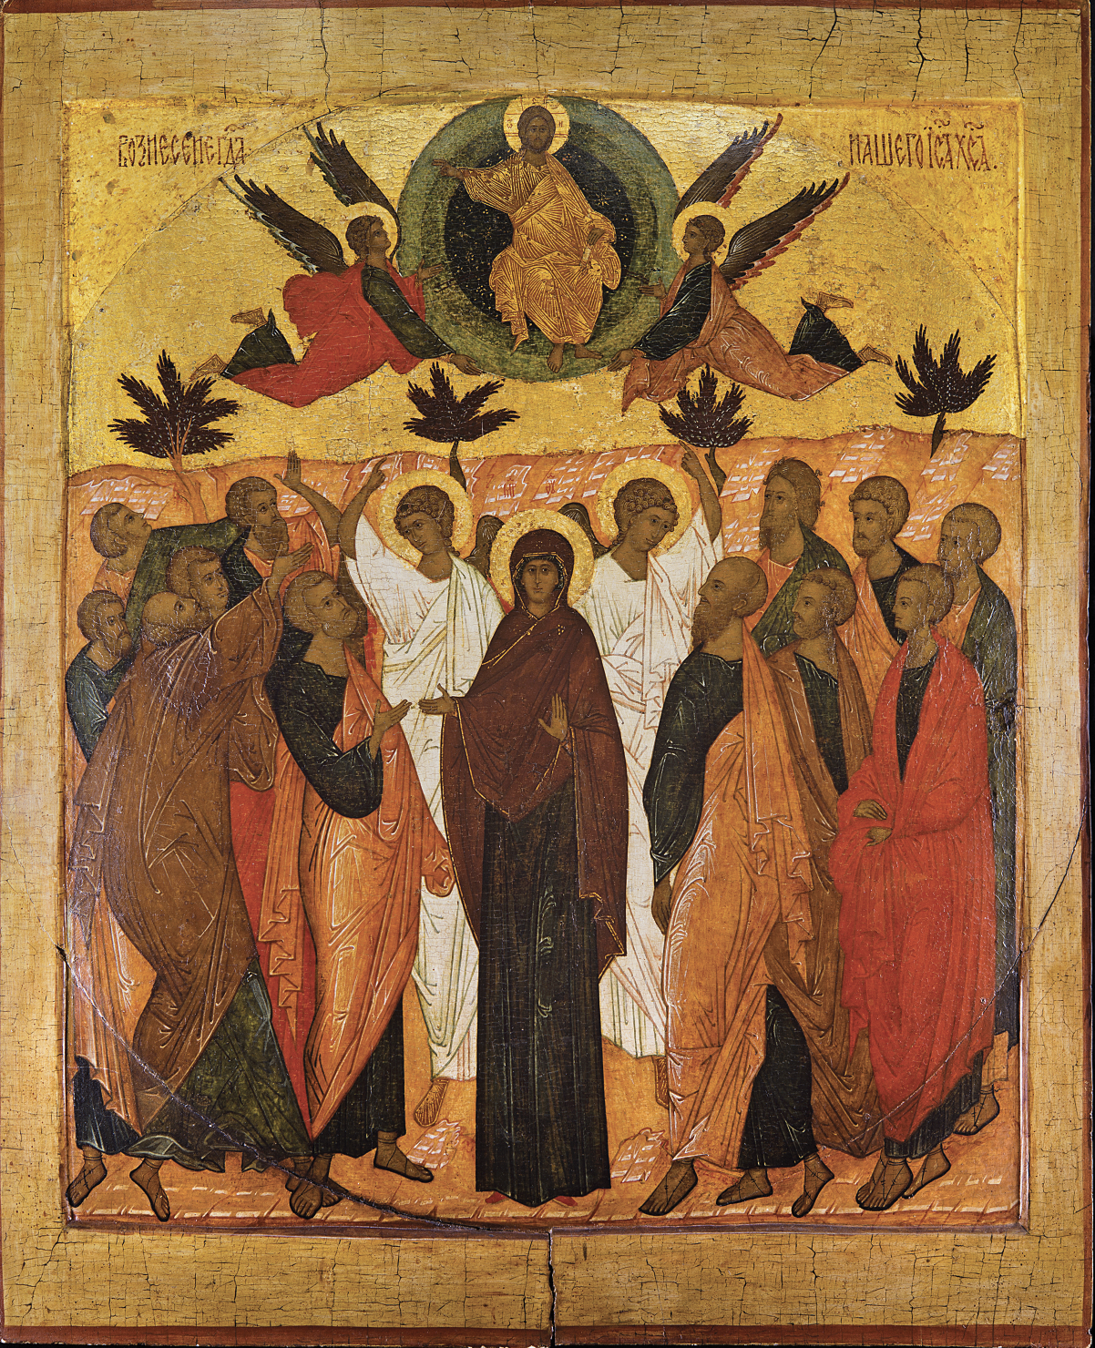
The Purpose of the Church
Why are We here?

Slide 2
The Great Commission (Matthew 28.18-20)
“And Jesus came and said to them, ‘All authority in heaven and on earth has been given to me. Go therefore and make disciples of all nations, baptizing them in the name of the Father and of the Son and of the Holy Spirit, teaching them to observe all that I have commanded you. And behold, I am with you always, to the end of the age.’”

Slide 3
“Go therefore and make disciples of all nations…” (Acts 10.34-43)
The message of the gospel is for all people. God doesn’t show partiality so neither should we.
The gospel is centered around Christ, His suffering, death, and resurrection for our sins. For us to follow Him, we must be willing to follow Him into suffering.
We have a choice to evangelize or fossilize. We have been given a task of telling the world of God’s love and sacrifice made for them.

Slide 4
“…baptizing them in the name of the Father and of the Son and of the Holy Spirit…” (Acts 8.26-40)
The willingness and courage of Philip and the humility of the eunuch lead us to this story of baptism.
The baptism we undergo echoes the submission of Christ.
When baptism is mentioned in the epistles, it is to those who have already received it. Baptism stands as a reminder to die to ourselves, daily in the service of Christ.

Slide 5
“…teaching them to observe all that I have commanded you.” (1st Peter 1.13-25)
What should be the goal of our teaching?
Call everyone to holiness. (v. 15-16)
Remind ourselves of the power and importance of the good news. (v. 17-21)
Pure love for God and for others. (v. 22-23)
If our teaching doesn’t emphasize these things, what are we doing?

Slide 6
“And behold, I am with you always, to the end of the age.” (1st John 4.7-16)
The way to know if we’re truly in Christ is by our love.
God is love. That truth gives us comfort in His ongoing faithfulness and the fact that He will never leave us.
God not only loves us dearly by dying for us, but also abiding in us. We are never alone if Christ lives in us.

Slide 7
Just some thoughts…
Do you see it as your duty to go, or do you believe it to be someone else’s?
Do you see baptism as the goal, or as the start and reminder of lifelong dedication?
Do you see the point of teaching to grow in holiness and love?
Do you know that Christ is with you? Do you encourage others in the church of this fact?

