Slide 1
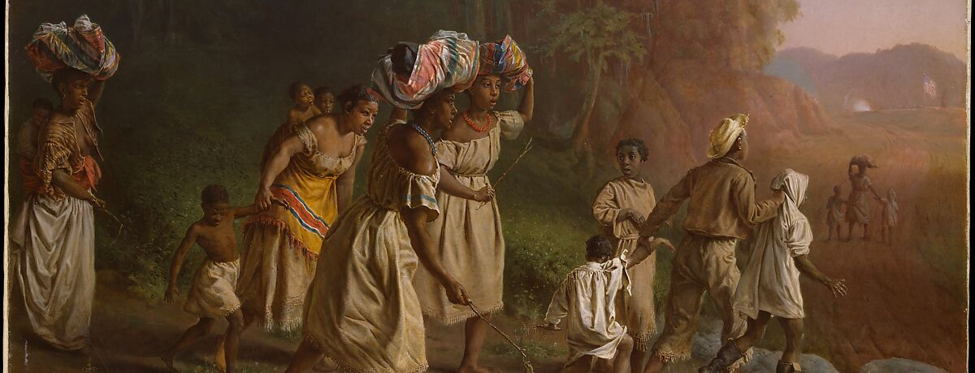
Conviction, Context, and
Compassion
2/4/2024

Slide 2
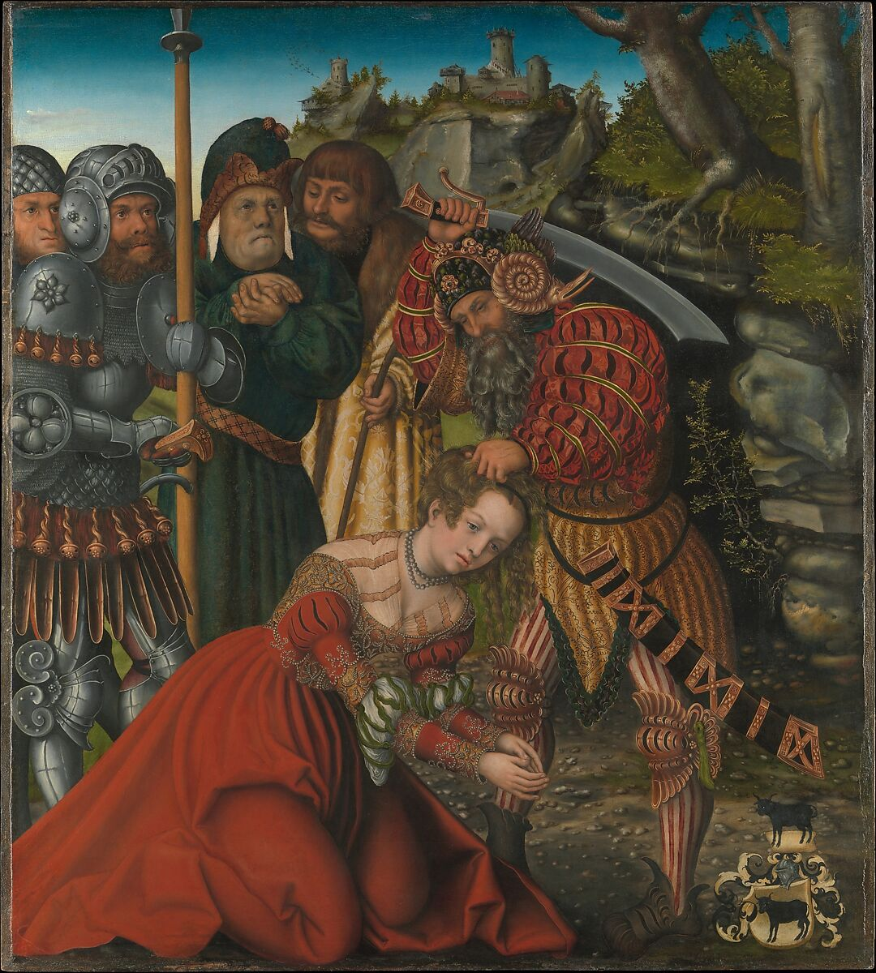
Psalm 53.1-6
“A fool says in his heart, ‘there is no God’”
What does this Psalm teach?
  Evil comes from rebellion against God.
  All of us have turned against God and rebelled.
  God’s mercy brings salvation for those who trust in Him
  Our wisdom doesn’t make us more worthy. All we have is accepting God’s grace.

Slide 3
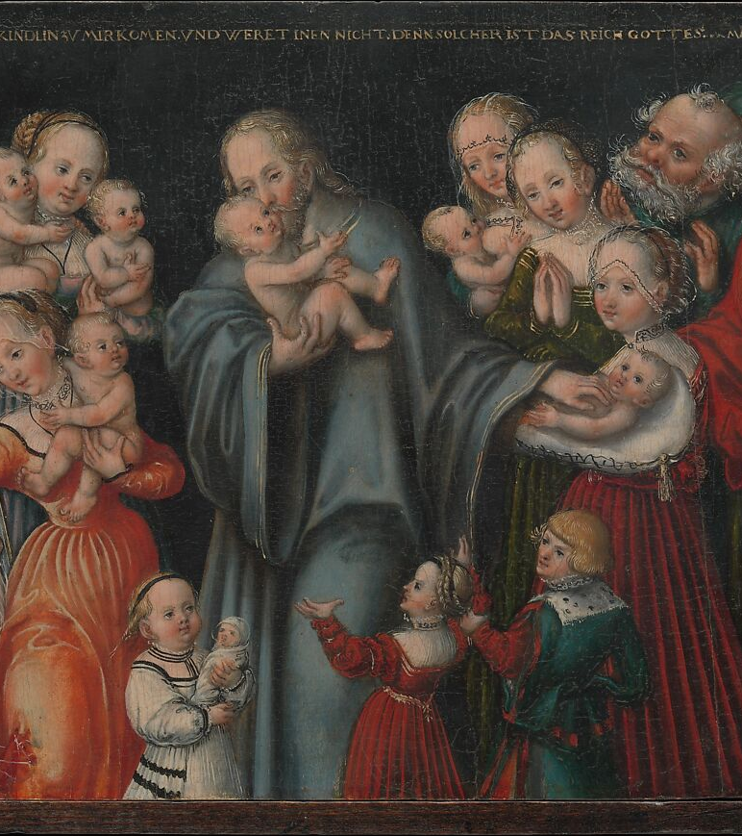
Isaiah 55.1-12
“His thoughts are not our thoughts…”
What does this chapter teach?
  God is the good king of the whole world – Jew and Gentile alike.
  He offers His kindness for free. Turn away from your sin and to Him!
  He will have compassion on the soul that even we can deem as “unworthy”. He desires to show abundant forgiveness.

Slide 4
2nd Timothy 3.1-9
This passage is not about the outside world. Instead, it is a critique of us – the church.
Are we so busy looking at the evil out there, that we become the very unholiness we’re hoping to avoid?
We need to embrace godliness, and let it transform us. We should be walking close to Jesus. It is evident to all people when we’re hypocritical.

Slide 5
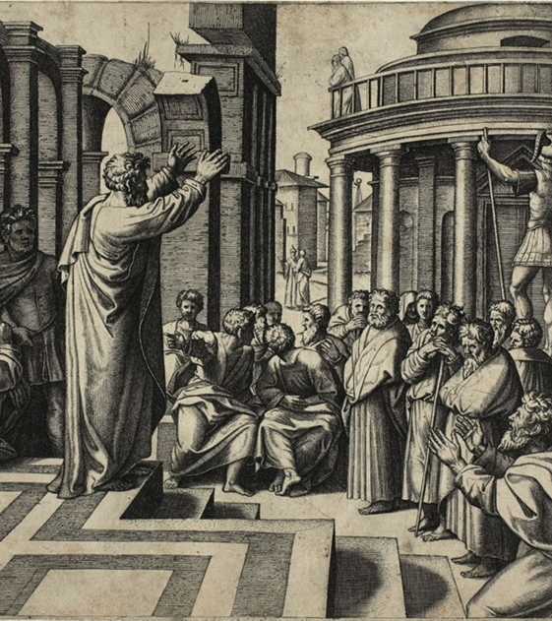
Some Advise for Engagement
Listen – Why would you expect them to listen to your message if you don’t listen to theirs? (Matthew 7.12)
Be Gentle and Respectful – No matter how angry someone gets at you, always convict with kindness and truth. (1st Peter 3.13-17)
Start where they are, always point to Jesus – Is the point of your discussion to win an argument, prove you’re smarter, or bring them to the hope of their souls? (Acts 17.16-34)

