Slide 1
A Message to Exiles

Slide 2
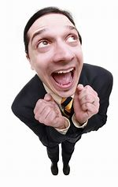
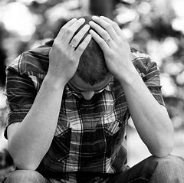
Two concerns after every presidential election
Candidate you voted for…
WON
LOST

Slide 3
Two concerns after every presidential election
Candidate you voted for…
WON
LOST
Both of these reactions put way too much influence on politics!
Notes:
Trump/Biden…. some of you think it will save the country, some of you think it is leading the country on a terrible path
Hard not to get wrapped up, enmeshed in all the politics so much so that the concerns of the kingdom of GOD gets overshadowed
Transition: We understand that the way and work of the kingdom of GOD is much different than the kingdoms of this world

Slide 4
The kingdom of GOD…
… is not of this world
John 18:36
Philippians 3:20
Polycarp
“Eighty-six years I have served CHRIST, and HE never did me any wrong. How can I blaspheme my KING who saved me?”
https://christianhistoryinstitute.org/study/module/polycarp/
Notes:
John 18:36…my kingdom is not of this world
He is a different sort of king with a different sort of power
Phillippians 3:20… our citizenship is in heaven and from it we await a savior the Lord Jesus Christ
City of Phillippi was a Roman colony…. a great honor to be a citizen of these Roman colonies like Phillippi
Paul says the citizenship you should be proud of is your heavenly citizenship, this is how you should identify yourself… we are in a home away from home, but that home is the presence of GOD, not Rome
Transition: Term Savior and Lord typically used of Caesar (from Phil 3:20)
The emperors of Rome had unleashed bitter attacks against the Christians during this period, and members of the early church recorded many of the persecutions and deaths. Polycarp was arrested on the charge of being a Christian -- a member of a politically dangerous cult whose rapid growth needed to be stopped. Amidst an angry mob, the Roman proconsul took pity on such a gentle old man and urged Polycarp to proclaim, "Caesar is Lord". If only Polycarp would make this declaration and offer a small pinch of incense to Caesar's statue he would escape torture and death. To this Polycarp responded, "Eighty-six years I have served Christ, and He never did me any wrong. How can I blaspheme my King who saved me?" Steadfast in his stand for Christ, Polycarp refused to compromise his beliefs, and thus, was burned alive at the stake.
Phillippians letter purposefully using these terms (“Savior” “LORD”) to remind these Christians where there citizenship is and who their Lord is
Transition: If our citizenship is in heaven, if our kingdom is not of this world, what does that make us?

Slide 5
Exiles
1 Peter 1:1, 2:11-13
Notes:
1 peter 1:1, 2:11… exiles… if your citizenship is not where you are, you are a sojourner, an exile, an alien
Christian living in Rome or Christian living in America under Obama/Trump you are in exile
Vs 12… you need to keep your behavior honorable, live exemplary lives
Vs 13… be exemplary citizens (paraphrasing)
Don’t ignore the blessing of citizenship, can be a blessing given by GOD, but like other blessings, if not used for GOD it can become GOD (Paul used his blessing of citizenship); instead of using it to further the gospel and kingdom of GOD it can consume us and we can become so preoccupied with these earthly affairs (compare to idols, many of them are things given to us to enjoy, but we turn them to idols)

Slide 6
Notes:
Order of priority is out of whack… sexual orientation, political ideology, then Christian, just ahead of gun ownership
Is this someone who understand their citizenship is in heaven, who are a part of a kingdom is not of this world? That their primary identity is not sexual orientation, citizenship of a country, etc, but as a Chrisitan…
True before the election, true after the election. The great commission was the task of Christians in the first century and is the task now. Jesus Christ was LORD long before the US ever became a nation and HE will still be LORD long after this nation goes the way every nation has ever gone. Chrisitans were strangers in exiles in the first century and we will be strangers in exile in the 21st century
If this makes you nervous you are not alone. This is not the only time GOD’s people has been exiled. In the OT the people of GOD were literally exiled

Slide 7
Exiles
1 Peter 1:1, 2:11-13
Jeremiah 29
Notes:
Jeremiah 29… most of the sermon
In the days of Israel’s exile there were prophets who did not want to accept they were going to be in Babylonian captivity for 70 years. They chafed under the notion they were exiles. They made false prophesies against what Jeremiah said. They sent letters in vrse 27… why have you not rebuked….? We don’t want to listen to this.
GOD responds angrily in verse 30 (read thru verse 32)
Transition: What are exiles supposed to do? How are they supposed to act? How should we act? 4 things

Slide 8
As exiles, how are we supposed to act?
Remember GOD is in control of history
Jeremiah 29:3-4
Notes:
a. 29:3-4
“whom I have sent into exile”
I have put you here
I am in control of history
Nebuchadnezzar? Just the human authority, but GOD is responsible
b. 25:8-12
Nebuchadnezzar is MY servant
GOD is calling the shots
c. 27
GOD tells Jeremiah to take an iron yoke on his neck as a visual aid and he tells them in verse 5…. Thru about 8?
Why was it important for them to know GOD was in control of history and that He put them into exile?
If GOD put them into exile He can bring them out because He is in control and that is what He promises to do
e. Application
GOD is in control of our history too
However the wind of politics blows we must be faithful to GOD and His purpose
In Acts, church begins and Bible says in beginning of Acts 2 it was in favor of all the people
When faces opposition, it begins to grow, no matter how much persecution, no matter what worldly powers oppose the gospel, it continues to grow;
Same thing will happen to us, no matter what regimes are in control, if we remain faithful to our task, confident that GOD is in control, His purpose will be done
Acts 14:27
GOD opening doors, using people
Being in exile doesn’t mean it is over, He will still use us because he is in charge of history
If election went in your favor, don’t worry. If election did not, don’t be complacent. GOD still rules, Jesus is still LORD and we need to get to work

Slide 9
As exiles, how are we supposed to act?
Remember GOD is in control of history
Take care of things at home
Jeremiah 29:4-6
“Your success as a family, our success as a society, depends not on what happens in the White House but on what happens inside your house.”
Barbara Bush
https://www.wcvb.com/article/look-back-barbara-bushs-controversial-wellesley-college-speech/19848166
Notes:
a. 29:4-6
Has always been GOD’s intent for us to be fruitful and multiply
More importantly, don’t put your life on hold
You may not be in your homeland but you can still have a home
Focus on marriage, children, and raising your childen
b. Application
Makes no difference who the president is, what legislation may pass, what courts decide… if your family is a mess
If spouses are committed to each other in Christ-centered, gospel modeling, grace oriented marriages, if oarents are raising kids in the discipline and instruction of the Lord, and securing their homes then whatever else may happen in their foreign world as an exile of heaven you can still be the people GOD wants you to be
There is not a problem in this country that cannot be traced back to the family
Anywhere crime is rampant, drugs are everywhere, schools are bad; then divorce is rampant, majority of kids are raised in single parent homes
If you want to make America great again first thing you need to do is make your family what GOD wants you to be
1. Be the spouse GOD wants you to be
2. The parent God wants you to be
3. The child GOD wants you to be
Barbara Bush “your success as a family our success as a nation depends not what happens in the White house but what happens in your house
Jeremiah says it doesn’t matter how far you are from Israel take care of your home
1. Same for us, perhaps now more than ever, Christians take care of your home
2. Be the kind of family people you ought to be in Jesus Christ

Slide 10
As exiles, how are we supposed to act?
Remember GOD is in control of history
Take care of things at home
Pray for the country
Jeremiah 29:7
1 Timothy 2:1-3
1 Peter 2:15-17
Notes:
a. 29:7
While you’re in this foreign country pray for it. Pray for its peace and prosperity
1 timothy 2:1-3a
Supplication, prayers intercessions, etc… all kinds of prayer for all kinds of people… this is good!
b. As Christians, we pray for our leaders and we respect them whether they believe in Jesus Christ, agree with our political beliefs, etc we do it cuz GOD said to
i. Civil government may change but kingdom of GOD does not change ii. Christians pray for whoever is in charge… always!
c. Who is Jeremiah telling these people to pray for?
Diff political party? People in same country? Actually the people who came into Israel, beat them down, and took them back to Babylon… their enemy!
d. Who is Paul telling them to pray for in 1 timothy? Nero… pagans, nuts and who persecute them yet still pray for them!
e. What is our excuse? We have a responsibility to pray for our leaders
1 peter 2:15-17 Tough… but what GOD wants us to do ii. Honor everyone
1. Times are bitter, lots of hate in political discourse
2. Christians can make a difference by choosing to honor everyone, treating everyone with dignity respect
3. If we let politics override Christianity all we see in our opponents are people to beat but if we maintain Christianity as our primary identity we love everyone
4. You can stand up for abortion and love someone, maybe Christians, who have made such a choice as they put their lives back together
5. You can stand up for traditional marriages and love someone who has chosen a homosexual lifestyle
6. You can point out the stark differences between the gospel and the Koran and love Muslims and treat them with respect
7. You can strongly disagree with someone on the opposite political aisle from you yet be willing to invite them into your home and show them
the love of CHRIST, show them your heavenly kingdom is more important than this earthly kingdom
8. Show a world consumed by hatred that you are from a different kingdom and you wo’t act that way. HONOR EVERYONE

Slide 11
As exiles, how are we supposed to act?
Remember GOD is in control of history
Take care of things at home
Pray for the country
Trust that exile will not last forever, because GOD promised it
Jeremiah 29:10-14
Philippians 3:20-21
Notes:
a. Jeremiah 29:10-11
i. A verse we hear often
ii. Completely out of context… sent to men and women in exile in Babylon having being beaten in war wondering if its ever going to end
iii. GOD says it will
b. Verse 12-14
i. Goes on to make several promises to his people of how they will be delievered out of exile
c. Application
i. We need to remember this, he is going to bring us back out of exile
ii. This world is not our home
iii. The reminder that we are going home helps us remember that all things, including politics, needs to be kept in the proper perspective
iv. Go back to Philippians 3:20,21
v. That’s what we are longing for
vi. While you are here be the best citizen you can be, use your rights for the good of the kingdom, but we realize there is something better which helps us to keep our priorities in check

Slide 12
Most important election ever?

Slide 15
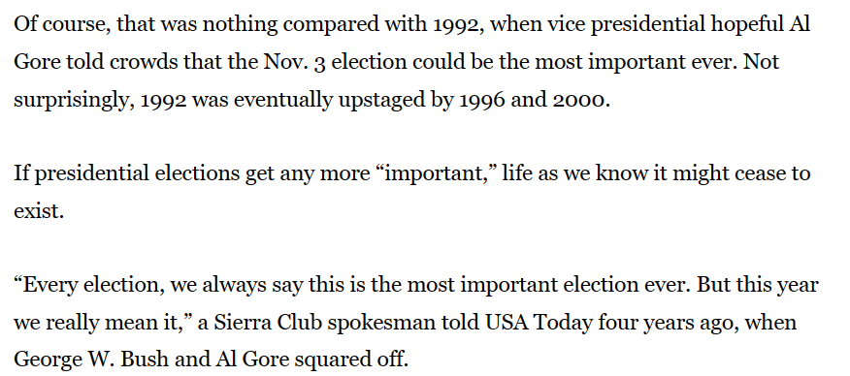

Slide 16
We are exiles
Remember GOD is in control of history
Take care of things at home
Pray for the country
Trust that exile will not last forever, because GOD promised it
Notes:
See a trend? We have a human tendency to get caught up in what’s happening in this world which causes us to panic, worry, lose our tempers, lose our priority’s when the truth is 1) GOD is in control and 2) this is not our home, our Father has rooms prepared for us when we get home. In the meantime, let’s take care of our families, pray for those in charge, and do our best to glorify and further the kingdom of GOD
Today is Easter Sunday, a day where people remember that our LORD died for us and was raised to death on the third day. All too often we remember this truth when we are between these four walls and as soon as we exit we forget we have been bought, that we are not citizens of this world, that we are exiles. If we really want to remember and honor the sacrifice of our LORD, let’s not get overly caught up in the things of this world. If things were so great here why would we need another home?
As this year progresses, let us show the world that not only is CHRIST alive, but HE is alive in us. HE has breathed new life into us. What a wonderful opportunity we have to live like men and women of faith. And to show other people what that looks like.

