Slide 1
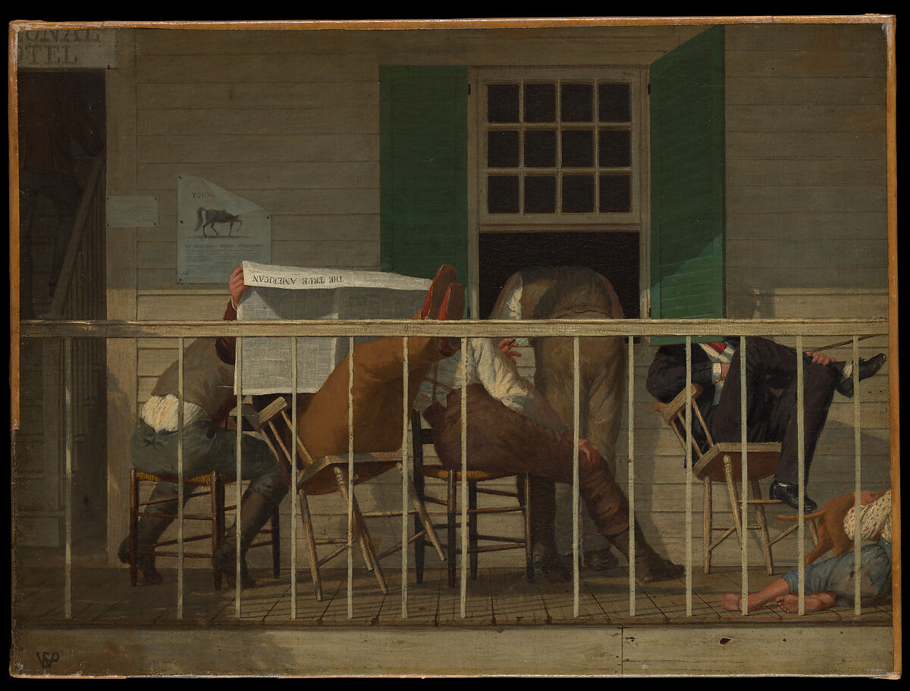
Unity in Christ
Philippians 4.2-4.23
“God Supplies Every Need”

Slide 2
Philippians 4.2-3 – Disagreeing Sisters
Euodia and Syntyche were fellow workers with Paul but were fighting with one another. We must not let pettiness or gossip interrupt the ministry.
The church has a responsibility to help people be reconciled to one another, not a place of further division.
With those who we disagree, do we demonize or treat them with love?

Slide 3
Philippians 4.4-7 - Peace Beyond Understanding
Christians are to let their reasonableness be known to everyone. Our patience, kindness, and pining for the truth should be well known.
Knowing the Lord is at hand frees us from anxiety: stop clinging to things that fail, cling to the unchangeable.
God’s peace that he gives us is “surpassing all understanding”. When our hope is anchored beyond this physical world, it is genuinely supernatural.
Trust in God. He will guard your mind and heart.

Slide 4
Philippians 4.8-9 – What Should We Think About?
In our information age, we need to have discretion.
Paul calls on us to focus on goodness and truth. As much as the world tries to force our attention elsewhere, we should be focused on the praiseworthy and honorable things.
God is the God of peace. Follow Him, and eternal peace is your hope.

Slide 5
Philippians 4.10-23 - Pleasing to God
Paul had been through all sorts of persecution. But he was given strength that had gotten him through everything: Christ.
But even with that, Paul allows others to serve them so others will be pleasing to God!
Trust God. He will supply every need.
Nero was seen as a god-king. But in His home, people had begun to worship the true King. The gospel is powerful everywhere.

Slide 6
For Meditation
Service: Let other people serve you! Ask other people if they can help you!
Joy: When you see someone doing well, rejoice with them!
Peace: The world is a disorienting place: taking Philippians 4.8 seriously. The way to peace is through meditation on worthy things.

Slide 7
